Slide 1
Topic B:
Electrons
Readings: Chapter 6 in BLM 11th

Slide 2
Bohr Model of the Atom
The Rutherford/Bohr model formulated the idea of an atom comprised of a dense nucleus (containing positive protons and neutral neutrons), surrounded by orbiting, negative electrons.
Based on the attraction between the oppositely charged protons and electrons, and is governed by Coulombs law
Coulombs Law states - that the force between two charged particles, q₁ and q₂, is inversely proportional to the square of the distances between them.

Slide 3
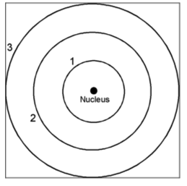
When q₁ and q₂ have the same sign, the force is repulsive, and when they are of opposite signs, the force is attractive
Bohr’s suggested that electrons could only travel in fixed orbits or shells (1, 2 and 3 etc. below) around the nucleus.

Slide 4
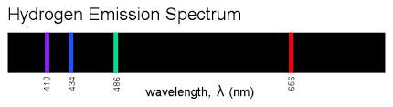
Using a spectroscope, he found that gaseous elements emitted electromagnetic radiation when heated.
The light that was emitted consisted of discrete packets of energy (quanta), and each element emitted a unique pattern of radiation.
The release of radiation resulted from electrons absorbing energy and moving to a shell further away from the nucleus.
When the electron falls back to the lower energy shell, it releases the energy that was absorbed.
This release of energy creates a line in a spectrum.

Slide 5
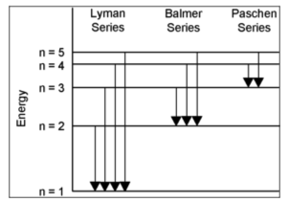
Since the shells are in fixed positions, the difference in energies between them (and hence the wavelength of the line in the spectra created by the electron returning to the ground state), is also fixed.
This gives a unique and identifiable pattern for each element.
.

Slide 6
Sometimes an electron gains enough energy to overcome the force of attraction from the nucleus and is removed from the atom.
The energy required to cause this is different for each electron and is called its ionization energy
Since all electrons sit at different distances from the nucleus and the force of attraction is partly dependent upon the distance between the nucleus and the electron.

Slide 7
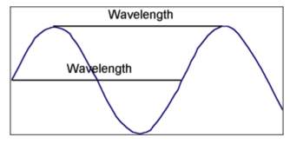
Electronic Configuration
Bohr’s model did not explain several of the electrons properties.
Work by de Broglie suggested that the electron also had some wave like characteristics
All electromagnetic radiation (EMR) can be described as waves that are defined by the properties of wavelength and frequency.
  Wavelength (λ) - the distance between two repeating points on a sine wave.

Slide 8
Frequency (ν) - the number of waves that pass a fixed point in a second.
  measured in units of s⁻¹ or Hertz (Hz).
They are related to the speed of light:
Schrödinger solved wave equations to predict where an electron may be found in an atom.
His work along with the Heisenberg uncertainty principle led to the quantum mechanical model of the atom
  Three dimensional probability maps where an electron may be found at any point in time within each of the shells.
  These maps predicted by Schrödinger are known as orbitals and they describe the likely positions (or areas of space) of electrons within the atom

Slide 9
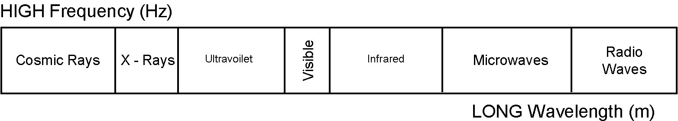
Depending on the value of the frequency and the value of the wavelength the radiation will fall somewhere in the electromagnetic spectrum according to the diagram below

Slide 10
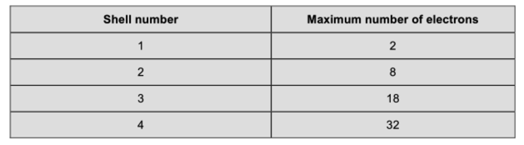
the maximum number of electrons present in each shell is given by 2(n²), where n is the shell number or energy level.
Therefore: maximum number of electrons in any energy level or shell in any atom is;

Slide 11
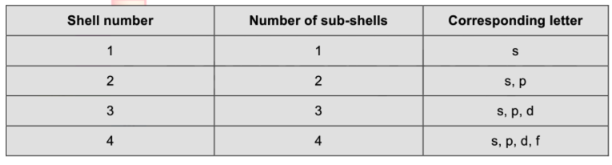
Each shell is further divided into sub-shells.
The number of sub-shells within any given shell is equal to the shell number.
The sub-shells are given the letters s, p, d and f.
    The first sub-shell is an s sub-shell,
    the second is a p sub-shell,
    the third is a d sub-shell
    and the fourth is an f sub-shell.

Slide 12
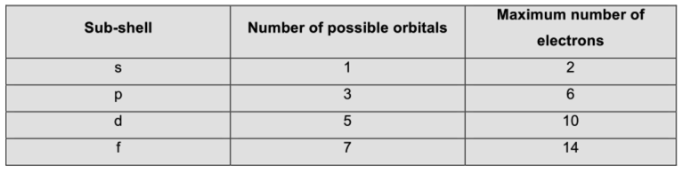
Each sub-shell is further divided into orbitals.
  The s, p, d and f sub-shells are split into 1, 3, 5 and 7 orbitals
  Each orbital can hold a maximum of two electrons.

Slide 13
Electron Spin
The Pauli exclusion principle says that all of the electrons in any single atom must be unique.
If a pair of electrons are in the same orbital:
  their shell, sub-shell and orbital are all the same!
They must be distinguished by another method.
This is achieved by giving the electrons an intrinsic property known as ‘spin’.
Two electrons in the same orbital are given opposite spins,
  denoted as a pair of arrows, one pointing up and one pointing down,
  or sometimes the numbers +½ and –½.

Slide 14
S orbitals

Slide 15
P orbitals

Slide 16
P Orbitals

Slide 17
D orbitals

Slide 18
F orbitals

Slide 19
F orbitals

Slide 20
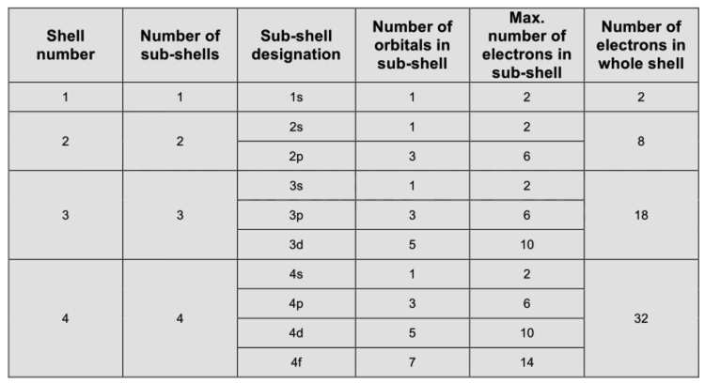
Summary of shells, sub-shells, and Orbitals

Slide 21
Arranging electrons in the atom
Aufbau Principle:
  Electrons occupy the orbitals of lowest energy first.
Pauli Exclusion Principle:
  No more than two electrons may occupy an orbital
Hund’s Rule:
  Within a sublevel, electrons will fill separate orbitals first then double up.
Examples on the board.

Slide 22
Valence electrons:
  the electrons in the outermost energy levels (highest energy level).
Core electrons:
  the inner electrons, any electrons that are not valence electrons.
**Using the periodic table to write electron configurations.
  Task 1Bi (page 17)

Slide 23
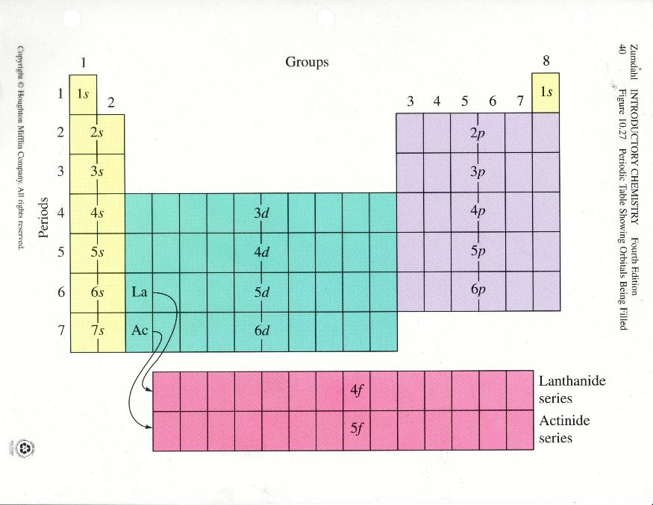

Slide 24
ATOMIC NUMBER | SYMBOL | NUMBER OF ELECTRONS | ELECTRONIC CONFIGURATION
1 | H | 1 | 1s¹
2 | He | 2
3 | Li | 3
4 | Be | 4
5 | B | 5
6 | C | 6
7 | N | 7
8 | O | 8
9 | F | 9
10 | Ne | 10

Slide 25
ATOMIC NUMBER | SYMBOL | NUMBER OF ELECTRONS | ELECTRONIC CONFIGURATION
10 | Ne | 10
11 | Na | 11
12 | Mg | 12
13 | Al | 13
14 | Si | 14
15 | P | 15
16 | S | 16
17 | Cl | 17
18 | Ar | 18

Slide 26
ATOMIC NUMBER | SYMBOL | NUMBER OF ELECTRONS | ELECTRONIC CONFIGURATION
19 | K | 19
20 | Ca | 20
21 | Sc | 21
22 | Ti | 22
23 | V | 23
24 | Cr* | 24
25 | Mn | 25
26 | Fe | 26
27 | Co | 27

Slide 27
ATOMIC NUMBER | SYMBOL | NUMBER OF ELECTRONS | ELECTRONIC CONFIGURATION
28 | Ni | 28
29 | Cu* | 29
30 | Zn | 30
31 | Ga | 31
32 | Ge | 32
33 | As | 33
34 | Se | 34
35 | Br | 35
36 | Kr | 36

Slide 28
Details
To determine the electronic configuration of any element, build the electronic configuration by following the steps below.
The period number shows the shell number. NOTE: When filling the d orbitals, subtract one from the period number to determine the correct shell.
The block shows the type of orbital.
Then add one electron for each element until the orbital, then sub-shell and ultimately the shell, is full.
Record the electronic configuration in the format;

Slide 29
Details
Elements in the same column (group) have the same electron configuration.
Columns have similar properties because of the same electron configuration.
Valence electrons are in the outermost principle quantum level
Valence electrons are the most important because they are involved in bonding.
Noble gases have filled energy levels.
Transition metals are filling the d orbitals

Slide 30
Exceptions
Ti = [Ar] 4s² 3d²
V = [Ar] 4s² 3d³
Cr = [Ar] 4s¹ 3d⁵
Mn = [Ar] 4s² 3d⁵
Half filled orbitals are more stable than partially filled orbitals.
Scientists aren’t sure of why it happens
same for Cu [Ar] 4s¹ 3d¹⁰

Slide 31
Noble gas core method of expressing electronic configuration
In this method the electronic configuration is determined by writing the previous noble gas in square brackets and then filling orbitals as before.
Example:
  For phosphorus - neon (Ne) is the previous noble gas, and the electrons that follow neon are in the 3s and 3p sub-shells
  This eliminates the need to write, 1s² 2s² 2p⁶ for Ne, and the noble gas configuration for P becomes; [Ne] 3s² 3p³

Slide 32
Ions and electronic configuration
Ions - charged particles that are formed by the loss or gain of electrons;
  positive ions - formed by losing electrons
  negative ions - formed by gaining electrons.
Magnitude of the charge indicates number of electrons lost or gained.
Electrons are either removed or added to the outermost shell meaning that
** When forming positive ions, d block elements lose their outer s electrons before any d electrons.

Slide 33
Task 1Bii
To find the electronic configuration of an ion
  remove or add electrons from the electron configuration of the neutral atom.
  1. Write the electronic configuration of the following using the noble gas core method.
    (a) Cu
    (b) Co
    (c) Ca
    (d) C
    (e) Ar
    (f) Ga

Slide 34
Task 1Bii
To find the electronic configuration of an ion
  remove or add electrons from the electron configuration of the neutral atom.
  2. Write the electronic configuration of the following simple ions using the noble gas core method.
    (a) F⁻
    (b) Ca²⁺
    (c) S²⁻
    (d) Na⁺
    (e) Al³⁺

Slide 35

Electrons in boxes (orbital diagrams)
Orbital diagrams – arrows (one up and one down to represent the different ‘spins’) show the electrons in each orbital and boxes represent the orbitals.
Degenerate orbitals (attached boxes), avoid having electrons paired until it is absolutely necessary (Hund’s rule).

Slide 36

Task 1Biii - Fill in the following orbital notation for each element

Slide 37
Using Photoelectron Spectroscopy (PES) as evidence for electronic configuration
Using high-energy ultraviolet or X-ray photons, it is possible for electrons in an atom to absorb sufficient energy for them to overcome their attraction for the nucleus and to be ejected from the atom.
This is called the photoelectric effect.
PES is used to gather data about the specific electronic structure of an atom.

Slide 38
The photons used to eject electrons have energies given by E = hν h = plank’s constant
                ν = frequency
These energies can exceed the ionization energy (IE) (see below), and
  (1) electrons overcome the attraction of the nucleus and are ejected from the atom, and
  (2) they gain kinetic energy (KE).
  hν = IE + KE
  The analysis of the kinetic energy of the ejected electrons produces a PES spectrum that gives information about the electronic structure of the atom.

Slide 39
Interpreting Photoelectron Spectra
Consider the simulated PES plot for magnesium on the next slide.
1. The three ‘levels’ of the x-axis allow the plot to be condensed into a smaller space, and in reality this is just one continuous scale from 0 to 500.
2. Sometimes you will see the ascending x-axis scale going from right to left (not left to right as below).
  You must look at the axes and scales carefully in simulated PES plots.

Slide 40
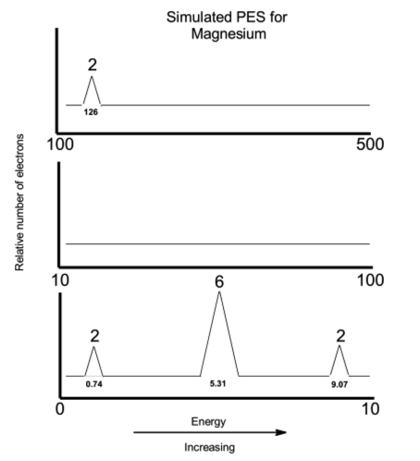

Slide 41
X- axis = the energy associated with each sub-shell in electron volts (eV) or MJ mol⁻¹
Y- axis = the relative number of electrons
( larger or higher peaks mean a greater number of electrons.)
Coulombs law predicts that electrons that are the furthest away from the nucleus are the easiest to remove, and therefore have the lowest energy.

Slide 42
In this example, there are:
  two electrons with very low energies (0.74),
  eight with intermediate energies (between 5.31 and 9.07), and
  two with very large energies (126).
This corresponds to an electronic configuration of
1s² 2s² 2p⁶ 3s² for Mg.

Slide 43
In an atom of magnesium,
  The two, 3s electrons, furthest from the nucleus are the easiest to remove (0.74)
  The six, 2p electrons, are next easiest to remove (5.31)
  The two, 2s electrons, are the next easiest to remove (9.07)
  The most difficult to remove are the two, 1s electrons (126), since they are the closest to the nucleus and as such experience the greatest force of attraction.
  The innermost electrons, i.e., those other than the valence electrons are called the core electrons.

Slide 44
1. Sodium has a total of four peaks in its PES spectrum. Energies in MJ mol⁻¹ are 0.50, 3.67, 6.84 and 104 respectively.
  (a) Explain the existence of four separate peaks in the spectrum.
  (b) Suggest the specific electrons and sub-shells that correspond to each peak.
  (c) Which peak would you expect to be the largest (greatest intensity)? Explain your answer.
2. Neon has an electronic configuration of 1s² 2s² 2p⁶.
  (a) How many unique peaks are expected in neon’s PES spectrum?
  (b) Which electrons correspond to the largest energies?
  (c) Which peak in the spectrum will have the greatest intensity (be the largest)? Explain your answer.
3. Which is the first element to exhibit a PES spectrum with five peaks? Explain.

Slide 45

Data for PES could also be presented in tabular form, with the label ‘ionization energy’ and units of kJ mol-1. (1 eV = 1.602 x 10-22 kJ)
The large "jump” (5x) between the 2nd and 3rd ionization energies shows it is relatively easy to remove the 1st two electrons, but extremely difficult to remove the 3rd.
The 3rd electron is a core electron,
  closer to the nucleus,
  experiences a greater pull from the nucleus
  more difficult to remove.
  Therefore – higher ionization energy. This means the first two electrons are the valence electrons and that the element is in group 2 !

Slide 46
There is another large "jump" between the 10th and 11th ionization energies – indicates the start of the inner (1st) shell.
Note that the first electron is removed from a neutral atom, and the second (and subsequent electrons) from positive ions.
Therefore - the 1st, 2nd, 3rd etc. ionization energies are different.
However, for PES,
  any electron can be removed at any time, and in each case the electron will be removed from a neutral atom
  The observed PES energy will be the same for all electrons in any given sub shell.
  A single peak is associated with all of the electrons in any given sub-shell.

Slide 47
Other aspects of electronic configuration
Paramagnetism and diamagnetism
Paramagnetic species are:
  attracted by a magnet
  created when unpaired electrons are present in an atom.
Diamagnetic species are:
  slightly repelled by magnets
  occur when all electrons are paired.
Isoelectronic species
Isoelectronic species have the same electronic configuration.
  They must be distinguished by some other means, for example the number of protons present.

