Slide 1
Big Idea #5
Thermochemistry

Slide 2
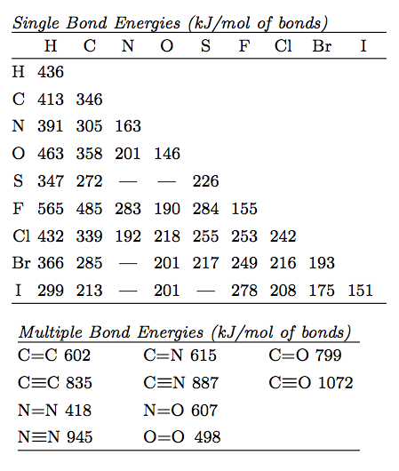
Bond Energy, Length & Strength
Source
Bond strength is determined by the distance between the atoms in a molecule and bond order. Multiple bonds(double, triple) shorten the distance & increase the force of attraction between atoms in a molecule.
Bond Energy is always ENDOTHERMIC –the energy needed to break the bond.
Video
3 Factors
1) Size: H-Cl is smaller than
H-Br
2) Polarity: HCl is more polar than H-C
3) Bond order (length) C=C involves more e- is shorter than C-C.
Lowest PE =Bond Energy
LO: 5.1 The student is able to create or use graphical representations in order to connect the dependence of potential energy to the distance between atoms and factors, such as bond order and polarity, which influence the interaction strength.

Slide 3
LO 5.1 Practice FRQ from 2005 B
Reveal Answer

Slide 4
Maxwell –Boltzmann Distributions
Source
Temperature is a measure of the average Kinetic Energy of a sample of substance.
Particles with larger mass will have a lower velocity but the same Average KE at the same Temperature.
Kinetic Energy is directly proportional to the temperature of particles in a substance. (if you double the Kelvin Temp you double the KE)
The M-B Distribution shows that the distribution of KE becomes greater at higher temperature.
The areas under the curve are equal and therefore the number of molecules is constant
Increasing Temperature (KE) increases the number of particles with the Activation Energy necessary to react.
Activation Energy is not changed with temperature but may be changed with a catalyst.
Video
LO 5.2: The student is able to relate Temp to motions of particles in particulate representations including velocity , and/ or via KE and distributions of KE of the particles.

Slide 5
LO 5.2 Practice FRQ from 2011 B
Reveal Answer
Reveal Answer

Slide 6
Thermodynamic vocabulary
Source
Universe: The sum of the system and surroundings
System: The species we want to study
Surroundings: the environment outside the system
Endothermic: Heat flows to the system from the surroundings (surroundings temperature drops-i.e. beaker feels cold)
Exothermic: Heat flows from the system to the surroundings. (surroundings temperature rises-i.e. beaker feels hot)
Video
LO 5.3: The student can generate explanations or make predictions about the transfer of thermal energy between systems based on this transfer being due to a kinetic energy transfer between systems arising from molecular collisions.

Slide 7
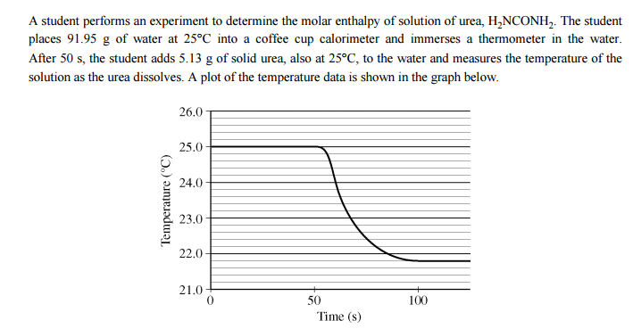
LO 5.3 Practice FRQ from 2010
Reveal Answer

Slide 8
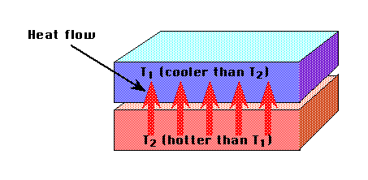
Heat Transfer
Source
Kinetic energy transferred between particles of varying temperature is heat energy.
Heat flows from particles of higher energy (hot) to those of lower energy (cold) when particles collide.
When the temperature of both particles are equal the substances are in thermal equilibrium.
Not all particles will absorb or release the same amount of heat per gram.
Specific Heat Capacity is a measure of the amount of heat energy in Joules that is absorbed to raise the temperature of 1 gram of a substance by 1 degree Kelvin.
Heat transfer can be measured q=mc_{p}∆T
Video
LO 5.3: The student can generate explanations or make predictions about the transfer of thermal energy between systems based on this transfer being due to a kinetic energy transfer between systems arising from molecular collisions.

Slide 9
LO 5.3 Practice FRQ continued from 2010
Reveal Answer

Slide 10
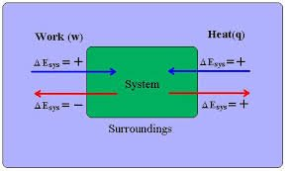
Conservation of Energy
Source
1st Law of Thermodynamics: Energy is conserved
Energy can be transferred as Work or Heat
∆E = q+w
Work = -P∆V (this is the work a gas does on the surroundings i:e the volume expanding a piston) a gas does no work in a vacuum.
Video
LO 5.4: The student is able to use conservation of energy to relate the magnitude of the energy changes occurring in two or more interacting systems, including identification of the systems, the type (heat vs. work), or the direction of the energy flow.

Slide 11
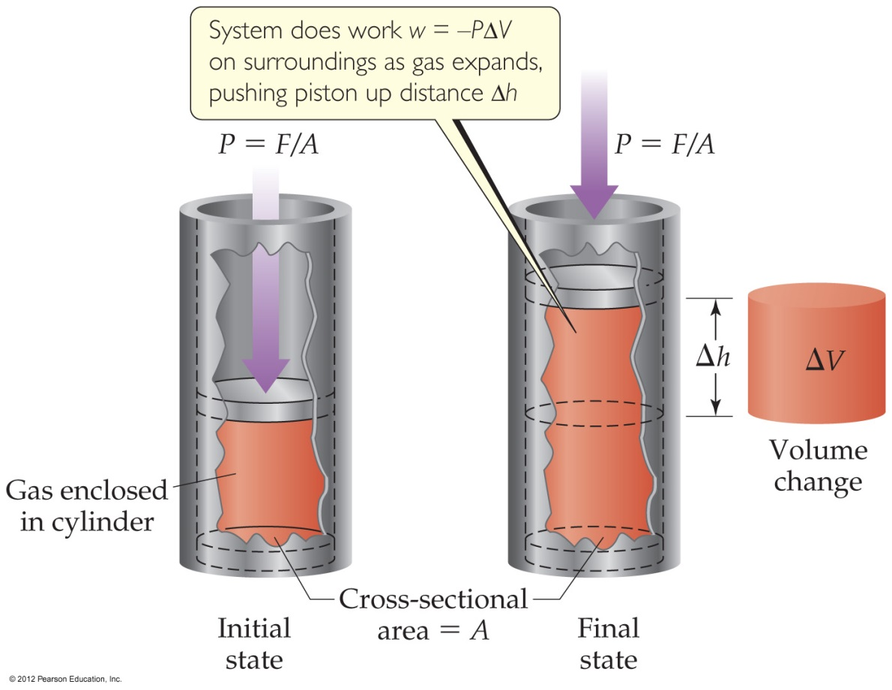
Conservation of Energy
Source
Video
Expansion/Compression of a gas
Volume increases, work is done by the gas
Volume decreases, work is done on the gas
LO 5.4: The student is able to use conservation of energy to relate the magnitude of the energy changes occurring in two or more interacting systems, including identification of the systems, the type (heat vs. work), or the direction of the energy flow.

Slide 12
Conservation of Energy when Mixing
Source
Energy is transferred between systems in contact with one another
Energy lost by one system is gained by the other so that total energy is always conserved.
-Q lost by system = +Q gained by surroundings
For example :
When room temperature water T1 (system) is mixed with cold water T2 (surroundings), the final temperature T3 will be in-between.
Q1 + Q 2 = 0 and energy is conserved
Video
LO 5.5: The student is able to use conservation of energy to relate the magnitudes of the energy changes when two non reacting substances are mixed or brought into contact with one another.

Slide 13
Calorimetry: an experimental technique used to determine the heat transferred in a chemical system. System can be a chemical reaction or physical process.
Source
Can use Calorimetry to solve for Heat Capacity of a calorimeter (C),, specific heat of a substance, (c), and ΔHvap, Δfus, ΔHrxn.
The data handling and math:
Law of Conservation of Energy: Q system + Qsurroundings = 0
Qsystem = - Qsurroundings where System = reaction, Surroundings = calorimeter
SO: Q rxn = - Q calorimeter
Heat Transfer due to Temperature Change in the Calorimeter:
Q= CΔT, or Q= mc ΔT where Q in J, C in J/K, m in g, c in J/g-K, ΔT in K
Q rxn = - Q calorimeter = - CΔT if the calorimeter Heat Capacity is Known, or can be determined.
Q rxn = - Q calorimeter = - mcΔT for reactions in solution.
When calculating ΔH, must take into account the mass of reactant that caused Q rxn.
Video
Example problem in video
LO 5.5: The student is able to use conservation of energy to relate the magnitudes of the energy changes when two non-reacting substances are brought into contact with one another.

Slide 14
LO 5.5 Practice FRQ from 2016
Reveal Answer

Slide 15
Chemical Systems undergo 3 main processes that change their energy: heating/cooling, phase transitions, and chemical reactions.
Source
1. Heat Transfer due to Temperature Change: (kJ)
Q= mcΔT
m= mass (g), c= specific heat capacity (J/g-°C), ΔT= Temp. change in °C
Q is + for Heating, - for cooling
2. Heat Transfer due to Phase Change: (kJ/mol )
Q= ΔH phase change
Q phase change = + for ΔH fusion, ΔH vaporizing, ΔH subliming, - for ΔH freezing, ΔH condensing, ΔH deposition
3. Q for a chemical reaction at constant pressure = ΔH rxn
When calculating ΔH rxn from Q, remember ΔH rxn must agree with the stoichiometric coefficients in the reaction. Units of ΔH rxn are kJ/mol rxn.
4. When a gas expands or contracts in a chemical reaction, energy is transferred in the form of Pressure- Volume work. W= -PΔV (l-atm)
Gas Expands – Does work on surroundings (system loses energy)
Gas Contracts – Work done on the gas (system gains energy) No change in volume, no work done.
Video
LO 5.6: The student is able to use calculations or estimations to relate energy changes associated with heating/cooling a substance to the heat capacity, relate the energy changes associated with a phase transition to the enthalpy of fusion/vaporization, relate energy changes associated with a chemical reaction to the enthalpy of the reaction, and relate the energy changes to PΔV work.

Slide 16
Calorimetry: an experimental technique used to determine the heat transferred in a chemical system. System can be a chemical reaction or physical process.
Source
Video
LO 5.7 The student is able to design and/or interpret the results of an experiment in which calorimetry is used to determine the change in enthalpy of a chemical process. (heating/cooling, phase transition, or chemical reaction) at constant pressure.

Slide 17
The net energy change during a reaction is the sum of the energy required to break the reactant bonds and the energy released in forming the product bonds. The net energy change may be positive for endothermic reactions where energy is required, or negative for exothermic reactions where energy is released.
Source
Any bond that can be formed can be broken. These processes are in opposition. (their enthalpy changes are equal in magnitude, opposite sign)
ΔH bonds breaking → ENDOTHERMIC (+)
ΔH bonds forming → EXOTHERMIC (-)
To find ΔHrxn, apply Hess’s Law:
ΔHrxn = ΣΔH bonds breaking (+) + Σ ΔH bonds forming (-)
To calculate or estimate ΔHrxn from Bond Energy:
Draw the Lewis Structure. Don’t forget about double and triple bonds!
Add up ΔH bonds breaking. It’s + (kJ)
Add up ΔH bonds forming. It’s - (kJ).
Add the two terms. Units are kJ/mol rxn.
To calculate ΔH°_{rxn} from a table of standard enthalpies of formation:
ΔH°_{rxn} = ΣΔH°_{f} products - ΣΔH°_{f} reactants
.
Video
If a reaction is EXOTHERMIC, there is a net release in energy, since weaker bonds break and stronger bonds form. Product has higher kinetic energy and lower potential energy than reactant.
If a reaction is ENDOTHERMIC, there is a net absorption of energy, since stronger bonds break, and weaker bonds form. Product has lower kinetic energy, and higher potential energy than reactant.
LO 5.8: The student is able to draw qualitative and quantitative connections between the reaction enthalpy and the energies involved in the breaking and formation of chemical bonds.

Slide 18
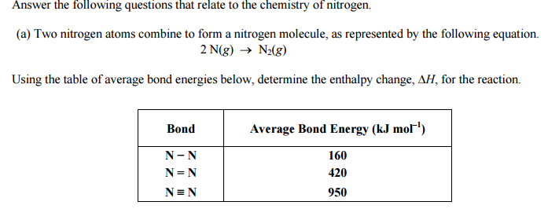
LO 5.8 Practice FRQ from 2003
Reveal Answer

Slide 19
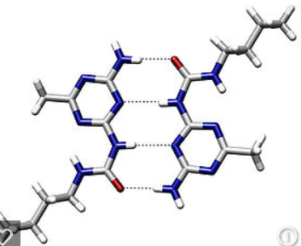
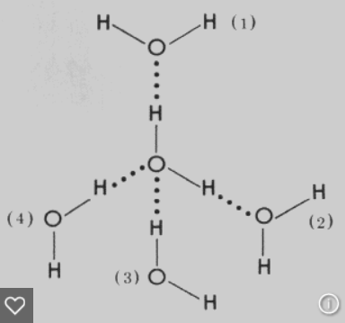
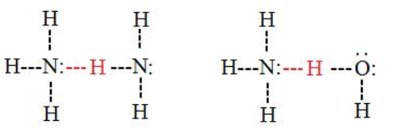
Electrostatic forces exist between molecules as well as between atoms or ions, and breaking these intermolecular interactions requires energy.
Source
The Stronger the IMF the more energy required to break it, the Higher the Boiling Point, the Lower the Vapor Pressure.
Intermolecular Forces Listed from weakest to strongest. Thus the boiling points and vapor pressure of molecular substances can be ordered based on IMF strength:
Dispersion (Induced Dipole- Induced Dipole): Caused by distortion of electron cloud. The larger the electron cloud, and the more surface area, the more polarizable the cloud, the stronger the dispersion force. Thus the boiling point trend in halogens is I₂ >Br₂>Cl₂> F₂ and n-butane (30.2° C) has a higher boiling point than isobutane (-11 °C). All substances have dispersion forces, as all electron clouds distort. Nonpolar molecules and atoms have only dispersion forces, as they have no permanent dipoles.
Dipole- Induced Dipole: Occurs between a polar molecule (HCl) and a nonpolar molecule. (Cl₂) The nonpolar molecule’s cloud distorts when affected by a dipole.
Dipole-Dipole: Occurs between 2 polar molecules. (HCl-HCl)
Hydrogen Bond: An extreme case of Dipole – Dipole. Occurs between molecules containing a H covalently bonded to F,O, or N. The “bond” occurs between the lone pair of F, O, or N, and the H which is attached to one of those elements.
Video
Weaker IMF, Lower Boiling, Higher Vapor Pressure
Stronger IMF, Higher Boiling, Lower Vapor Pressure
LO 5.9: Make claims and/or predictions regarding relative magnitudes of the forces acting within collections of interacting molecules based on the distribution of electrons within the molecules and the types of intermolecular forces through which the molecules interact.

Slide 20
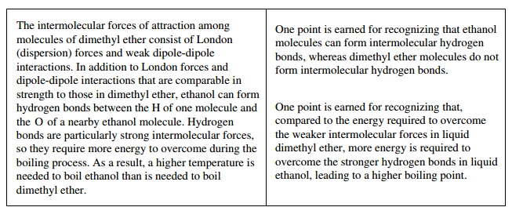
LO 5.9 Practice FRQ
Reveal Answer

Slide 21
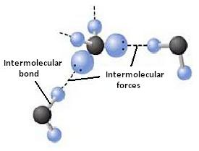
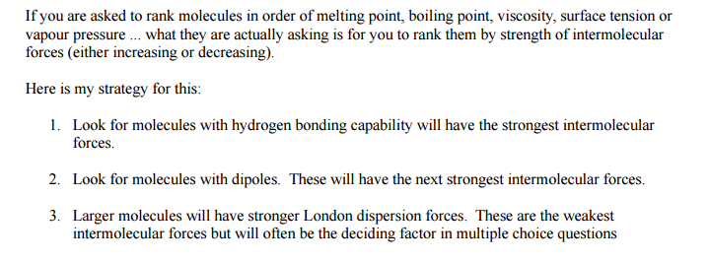
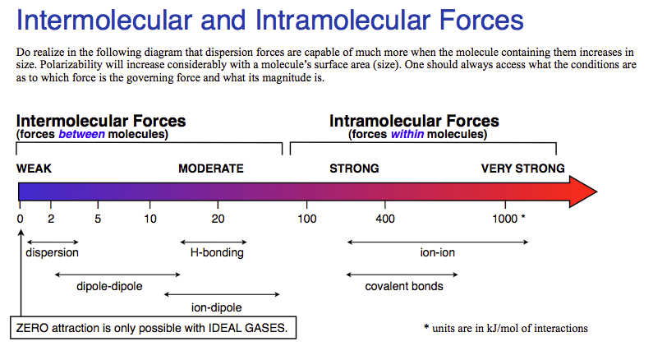
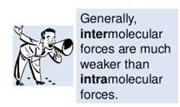
Inter vs Intra Chemical vs. Physical
Source
Source
Source
Source
Interstates- Between States
IMF- Between Molecules
Video
Note: this chart is only for comparing substances of similar sizes.
Chemical vs. Physical Changes
A physical change doesn’t produce a new substance. Phase changes are the most common. It involves IMF changes.
A chemical change produces new substances. Bonds are broken and new bonds are formed! The Intra-molecular forces are changed.
Strong IMF= High BP, High MP, High viscosity, high surface tension, low vapor pressure!
LO 5.10: The student can support the claim about whether a process is a chemical or physical change (or may be classified as both) based on whether the process involves changes in intramolecular versus intermolecular interactions.

Slide 22
LO 5.10 Practice FRQ from 2013

Slide 23
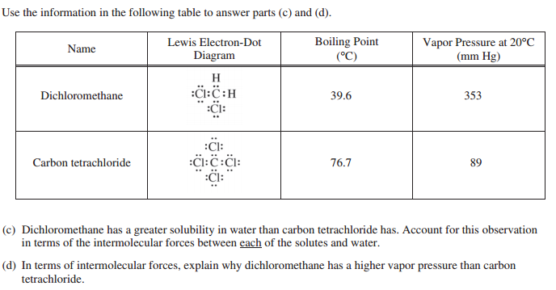
FRQ cont…

Slide 24
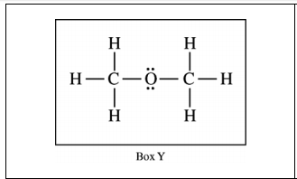
FRQ Answers 2013

Slide 25
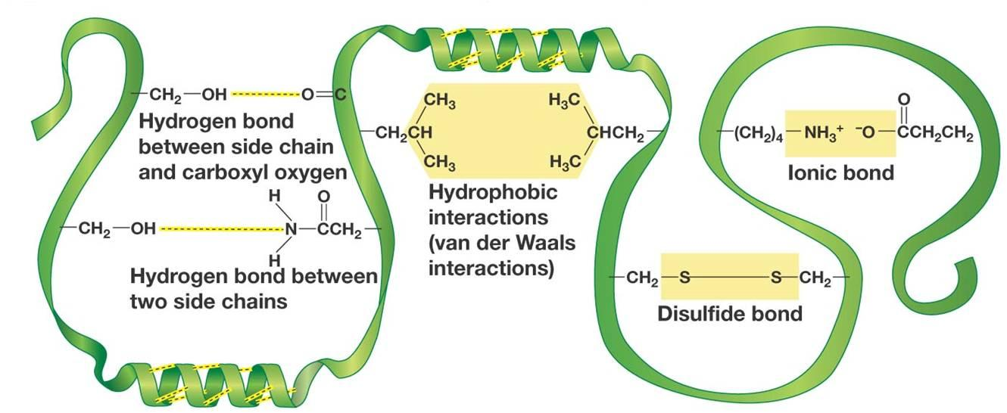
IMF and Biological/Large Molecules
Source
Source
Source
Video
LO 5.11: The student is able to identify the noncovalent interactions within and between large molecules, and/or connect the shape and function of the large molecule to the presence and magnitude of these interactions.

Slide 26
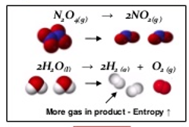
Entropy- Embrace the Chaos!
Source
Source
Entropy Changes that result in a + S:
Increasing moles
Increasing temperature
Increasing volume
Solid to liquid to gas
Forming more complicated molecules. (More moles of electrons)
Video
LO 5.12: The student is able to use representations and models to predict the sign and relative magnitude of the entropy change associated with chemical or physical processes.

Slide 27
LO 5.12 FRQ practice from 2006
Reveal Answer

Slide 28
Predicting How Reactions Will Go
Video #1
Video #2
Source
Entropy is typically given in J/K so you MUST convert to kJ!
LO 5.13: The student is able to predict whether or not a physical or chemical process is thermodynamically favored by determination of (either quantitatively or qualitatively) the signs of both delta Hº and delta Sº, and calculation or estimation of delta Gº when needed.

Slide 29
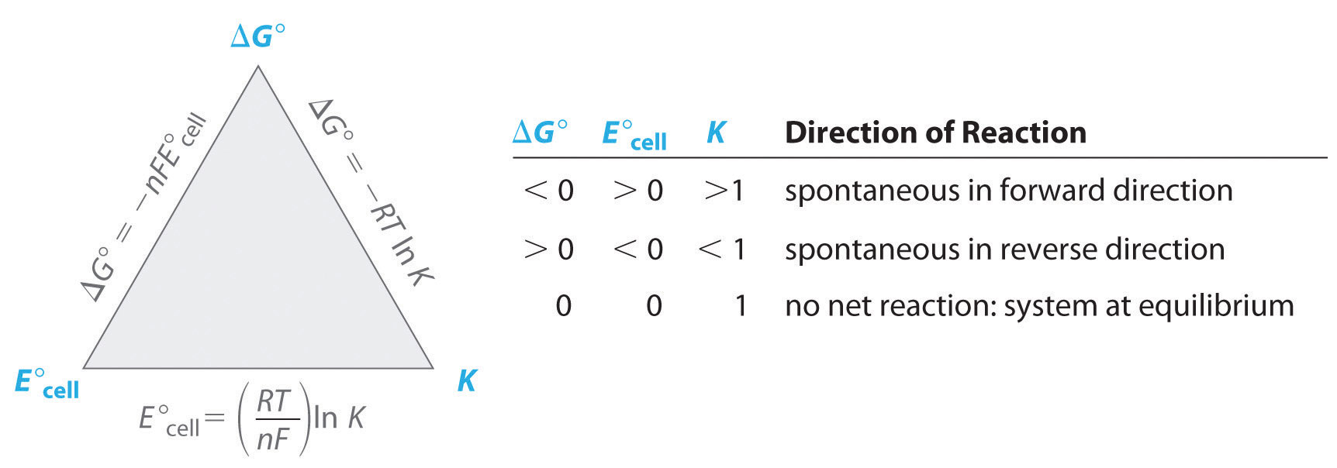
How can I calculate ΔG?
Source
Source
Video
Video
Video
ΔG$°=−nFE°$
LO 5.14: Determine whether a chemical or physical process is thermodynamically favorable by calculating the change in standard Gibbs free energy

Slide 30
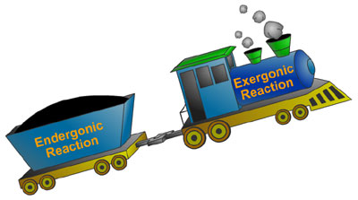
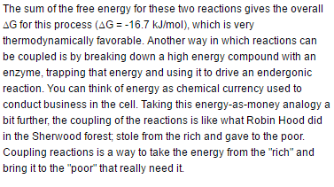
Coupling Reactions
Source
Video #1
ChooChoo
Exothermic Reaction
Endothermic Reaction
LO: 5.15 The student is able to explain the application the coupling of favorable with unfavorable reactions to cause processes that are not favorable to become favorable.

Slide 31
Source
Coupled Reactions and LeChatelier
Video
LO: 5.16 The student can use LeChatelier's principle to make qualitative predictions for systems in which coupled reactions that share a common intermediate drive formation of a product.

Slide 32
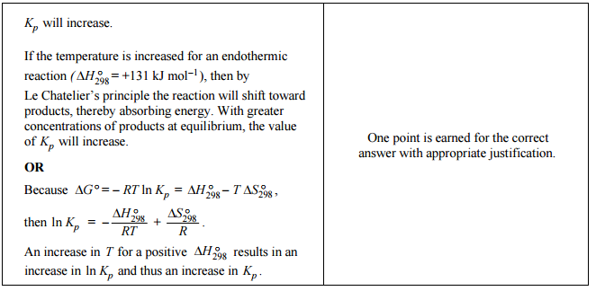
LO 5.16 FRQ Practice from 2009
Reveal Answer

Slide 33
COUPLING OF REACTIONS
Reactions with known values can be COUPLED to produce a new reaction.
When we couple reactions (or half-reactions), we may multiple by a factor or reverse the reaction before we couple or add them together.
Video
Coupled Reactions and K
Source
Source
Source
Manipulation | Equilibrium constants (K) | Free energy, enthalpy or entropy | Standard Reduction potential (Eº)
Multiply by factor | Raise K to power of factor | Multiply by factor | NOTHING!
Flip/reverse rxn | Inverse of K | Change sign | Change sign
Add Reactions | Multiply values | Add Values | Add values
LO 5.17: The student can make quantitative predictions for systems involving coupled reactions that share a common intermediate, based on the equilibrium constant for the combined reaction.

Slide 34
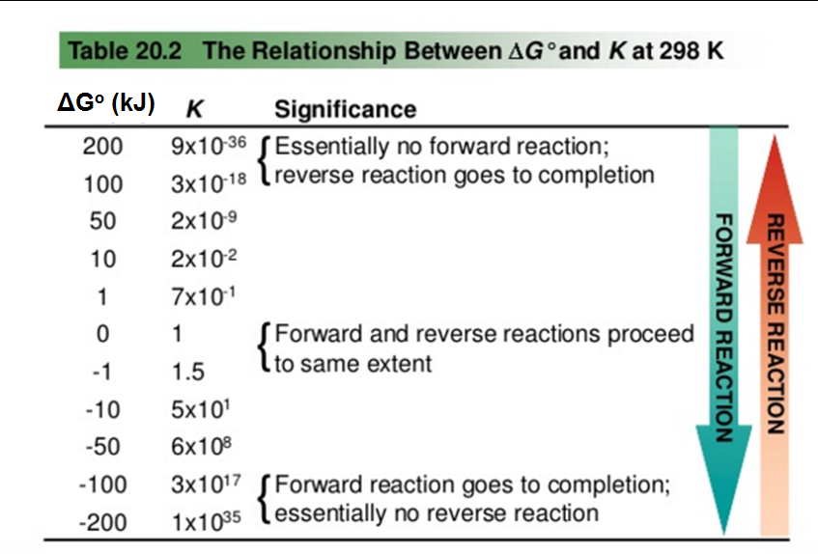
Is it thermo, kinetics, or K?
The free energy at non-standard, non-equilibrium states is given by:
At Equilibrium, ΔG = 0 and Q becomes “K”
Thermodynamically favorable (aka spontaneous) means a reaction is PRODUCT favored at a given temperature.
THERMODYNAMICALLY FAVORABLE
Kinetics tells us how FAST a reaction will proceed.
Equilibrium tells us how FAR a reaction proceeds.
Thermodynamics tells us whether or not the reaction is FAVORABLE at a given temperature.
A reaction that is thermodynamically favorable will form more products at equilibrium BUT the reaction may be so SLOW that few products form in a reasonable amount of time.
ΔGº and the Equilibrium Constant
Equilibrium constant | Description | Standard Gibbs Free Energy
K = 1 | Neither reactant nor product favored | ΔGº = 0
K > 1 | Product favored | ΔGº < 0 (thermodynamically favorable)
K < 1 | Reactant favored | ΔGº > 0 (thermodynamically unfavorable)
Video
ΔG ⁼ ΔGº + RTln(Q)
Source
Source
ΔGº = -RTln(K)
K > 1, ln(K) is positive, ΔGº is negative
ΔH
“Thermodynamically UNFAVORABLE” (aka non-spontaneous) reactions will run in reverse when set up with standard conditions (1M/1atm of ALL reactants and products) BUT can be made to proceed forward under different conditions. "
As K decreases, ΔGº becomes more positive
L 5.18: Explain why a thermodynamically favored chemical reaction may not produce large amounts of product (based on consideration of both initial conditions and kinetic effects), or why a thermodynamically unfavored chemical reaction can produce large amounts of product for certain sets of initial conditions.

Slide 35
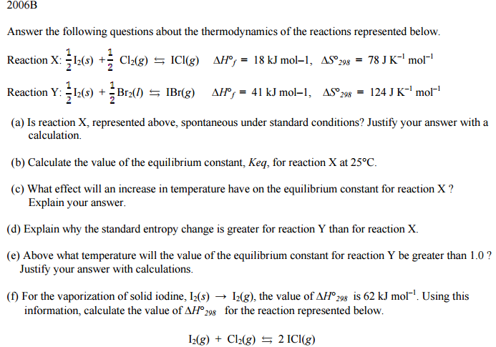
Practice FRQ for BI #5

Slide 36
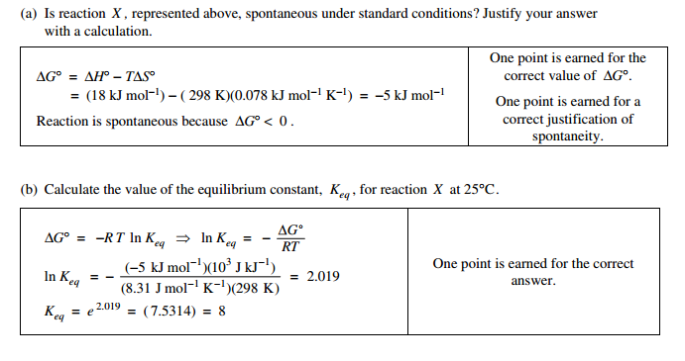
Answers to 2006 B

Slide 37
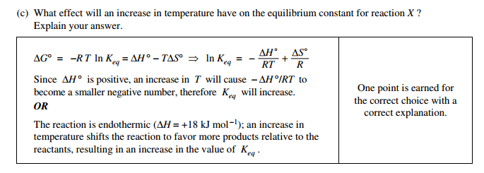
Answers cont…

Slide 38
Answers cont…

Slide 39
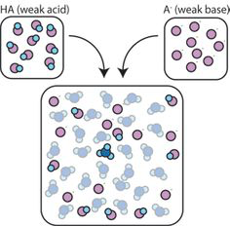
Big Idea #6
Equilibrium

Slide 40
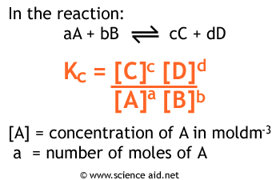
What is chemical equilibrium?
Source
Systems that have reached the state where the rates of the forward reaction and the reverse reaction are constant and equal.
It is a dynamic process where reactants continuously form products and vice versa, but the net amounts of reactants and products remain constant.
The proportions of products and reactants formed in a system at a specific temperature that has achieved equilibrium is represented by K, the equilibrium constant.
Video
LO 6.1: Given a set of experimental observations regarding processes that are reversible, construct an explanation that connects the observations to the reversibility of the underlying chemical reactions or processes.

Slide 41
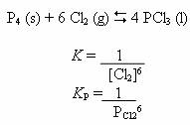
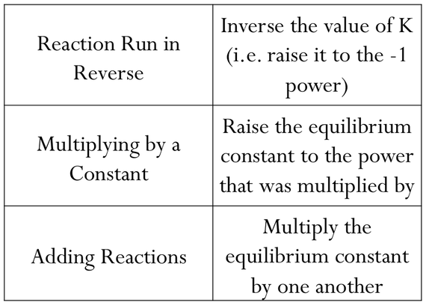
Manipulating Q and K
Source
K (equilibrium constant) represents the relative amounts of products to reactants at equilibrium at a given temperature.
Q (reaction progress) describes the relative amounts of products to reactants present at any point in the reaction at a given temperature.
Q and K only include substances that are gases or in aqueous solutions. No solids or liquids are ever included in these expressions.
Video
Similar reactions will have related K values at the same temperature.
Click reveals answer.
.35
LO 6.2: The student can, given a manipulation of a chemical reaction or set of reactions (e.g., reversal of reaction or addition of two reactions), determine the effects of that manipulation on Q or K.

Slide 42
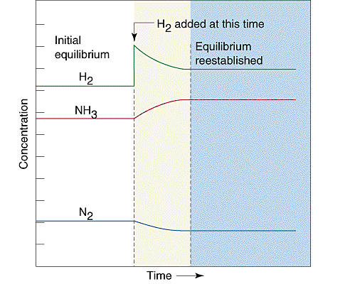
Kinetics and Equilibrium
Source
Kinetics examines the rate at which reactions proceed. Rate laws are used to describe how reactant concentrations affect a reaction’s rate. Rate constants (k) in rate law expressions are determined experimentally at a given temperature.
Equilibrium describes the state at which the rates of the forward reaction and the reverse reaction are constant and equal.
If the rates are initially unequal (the system is not at equilibrium), the faster direction depletes its reactants, which feeds back to slow down that direction.
At the same time, the slower direction accumulates its reactants, speeding up the slower direction.
Video
These loops continue until the faster rate and the slower rate have become equal.
In the graph to the right, after equilibrium has been achieved, additional hydrogen gas is added to the system. The system then consumes both H₂ and N₂ to form additional NH₃ molecules, eventually reestablishing equilibrium.
LO 6.3: The student can connect kinetics to equilibrium by using reasoning, such as LeChatelier’s principle, to infer the relative rates of the forward and reverse reactions.

Slide 43
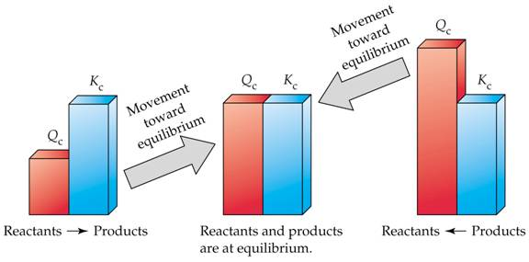
Q vs. K
Source
Equilibrium is reacted when the rates of the forward reaction and the rates of the reverse reaction are equal, which is when Q is equal to K.
Comparing Q to K enables us to determine if a chemical system has achieved equilibrium or will need to move towards reactants or products to reach equilibrium.
- if Q < K, the reaction will proceed in the forward direction until Q = K - if Q > K, the reaction will proceed in the reverse direction until Q = K - if Q = K, the reaction is at equilibrium, and the concentrations of reactants and products remain constant
Video
LO 6.4: Given a set of initial conditions and the equilibrium constant, K, use the tendency of Q to approach K to predict and justify the prediction as to whether the reaction will proceed toward products or reactants as equilibrium is approached.

Slide 44
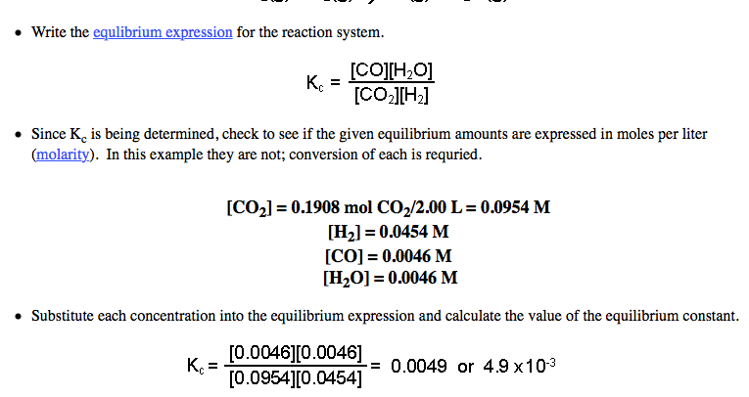
Calculating K
Source
Source
Equilibrium constants can be determined using experimental concentrations of reactants and products at equilibrium.
Steps: 1) Write an equilibrium expression 2) Determine equilibrium molar concentrations or partial pressures for all substances in expression 3) Substitute quantities into equilibrium expression and solve.
Video
Example: Calculate K for the following system if 0.1908 mol CO₂, 0.0908 mol H₂, 0.0092 CO, and 0.0092 mol H₂O vapor are present in a 2.00 L vessel at equilibrium:
Click reveals answer and explanation.
LO 6.5: The student can, given data (tabular, graphical, etc.) from which the state of a system at equilibrium can be obtained, calculate the equilibrium constant, K.

Slide 45
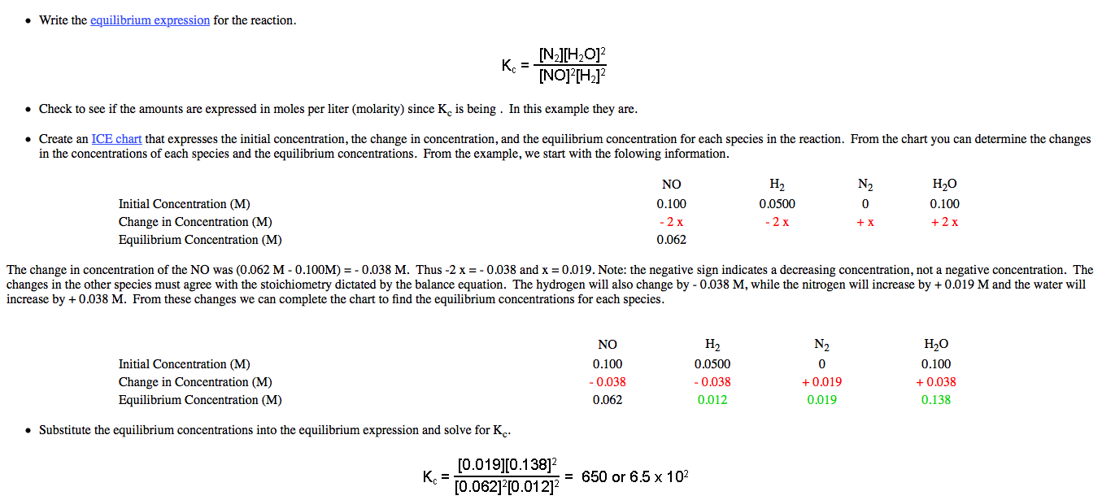
Calculating K
Source
Source
Equilibrium constants can also be determined from both initial and equilibrium concentrations using an ICE chart.
Steps: 1) Write an equilibrium expression 2) Determine molar concentrations or partial pressures for all substances in expression 3) Determine equilibrium concentrations or partial pressures using an ICE chart. 4) Substitute quantities into equilibrium expression and solve.
Video
Example: Initially, a mixture of 0.100 M NO, 0.050 M H2, and 0.100 M H2O was allowed to reach equilibrium. No N2 was present initially. At equilibrium, NO had a concentration of 0.062 M. Determine the value of K for the reaction:
Click reveals answer and explanation.
LO 6.5: Given data (tabular, graphical, etc.) from which the state of a system at equilibrium can be obtained, calculate the equilibrium constant, K.

Slide 46
Calculating Equilibrium Concentrations with K
Source
Equilibrium concentrations can be calculated using a K expression, the K constant, and initial concentrations or partial pressures of substances.
Steps: 1) Write an equilibrium expression for the reaction 2) Set up an ICE table and fill in “initial” quantities 3) Determine “changes” in the system in terms of x needed for the system to achieve equilibrium 4) Determine the “equilibrium” values for the system by adding the “initial” and “change” values together 5) Solve for x using the K expression and the “equilibrium” values. Verify if the change in initial concentrations is negligible using the 5% rule. 6) Determine all equilibrium quantities using the value of x
Example: Given the following reaction at 1373 K: Cl₂(g) 2Cl(g), determine the equilibrium partial pressures of all species if 0.500 atm Cl₂ is present initially. K = 1.13x10⁻⁴ for the reaction at 1373 K.
Video
Click reveals answer.
0.497 atm Cl₂ and
0.00752 atm Cl
LO 6.6: Given a set of initial conditions (concentrations or partial pressures) and K, use stoichiometric relationships and the law of mass action (Q equals K at equilibrium) to determine qualitatively and/or quantitatively the conditions at equilibrium for a system involving a single reversible reaction.

Slide 47
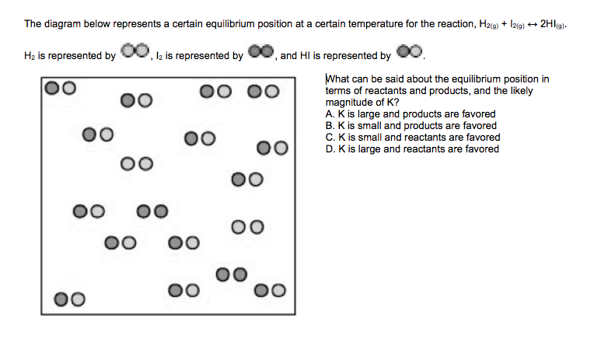
Magnitude of K
Source
For many reactions involving aqueous solutions, K is either very large (favoring the forward reaction) or very small (favoring the reverse reaction)
The size of K can be used to describe the relationship between the numbers of reactant and product particles present at equilibrium.
Video
LO 6.7: The student is able, for a reversible reaction that has a large or small K, to determine which chemical species will have very large versus very small concentrations at equilibrium.

Slide 48
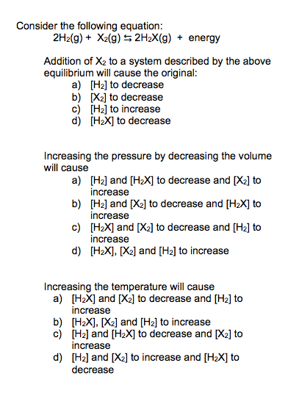
Le Chatelier’s Principle
Animation
Source
This principle is used to describe changes that occur in a system that has achieved equilibrium. There are three factors that can cause shifts in a system at equilibrium: concentration, pressure, and temperature.
Change | Direction System Shifts to Reestablish Equilibrium
Adding a reactant | Shifts towards products
Adding a product | Shifts towards reactants
Removing a reactant | Shifts towards reactants
Removing a product | Shifts towards products
Increasing pressure (decreasing volume) | Shifts toward less gas molecules
Decreasing pressure (increasing volume) | Shifts towards more gas molecules
Adding an inert gas | No effect
Increasing the temperature | Endothermic: shifts towards products Exothermic: shifts towards products
Decreasing the temperature | Endothermic: shifts towards reactants Exothermic: shifts towards products
Video
LO 6.8: The student is able to use LeChatelier’s principle to predict the direction of the shift resulting from various possible stresses on a system at chemical equilibrium.

Slide 49
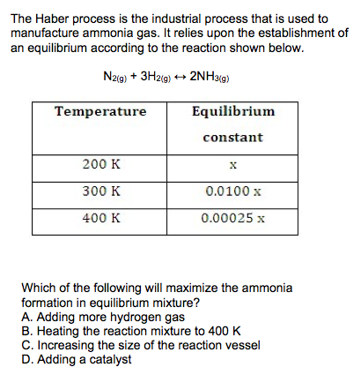
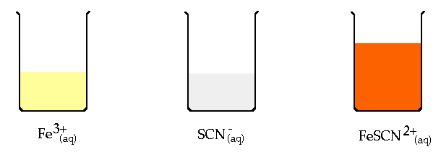
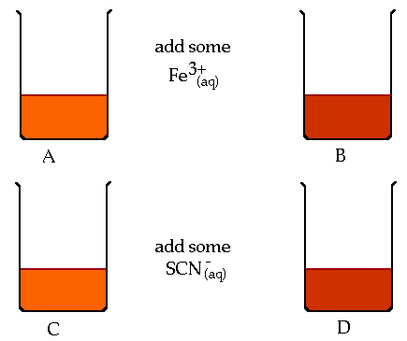
Experimentally Examining Le Chatelier’s Principle
Animation
Source
Systems at equilibrium can be examined using Le Chatelier’s Principle by measuring its properties, including pH, temperature, solution color (absorbance)
Video
Fe⁺³(aq) + SCN⁻(aq) FeSCN²⁺(aq)
LO 6.9: The student is able to use LeChatelier’s principle to design a set of conditions that will optimize a desired outcome, such as product yield.

Slide 50
Changes to Q and K for a System at Equilibrium
Animation
Some changes that occur to a system at equilibrium will affect the reaction’s current position (Q). Others will affect the value of K
Change | Direction System Shifts to Reestablish Equilibrium | Effect on Q or K
Adding a reactant | Shifts towards products | Q decreases
Adding a product | Shifts towards reactants | Q increases
Removing a reactant | Shifts towards reactants | Q increases
Removing a product | Shifts towards products | Q decreases
Increasing pressure (decreasing volume) | Shifts toward less gas molecules | Q can increase, decrease, or remain constant depending on ratio of gas molecules between reactants and products
Decreasing pressure (increasing volume) | Shifts towards more gas molecules
Adding an inert gas | No effect | Q doesn’t change
Increasing the temperature | Endothermic: shifts towards products Exothermic: shifts towards reactants | Endothermic: K increases Exothermic: K decreases
Decreasing the temperature | Endothermic: shifts towards reactants Exothermic: shifts towards products | Endothermic: K decreases Exothermic: K increases
Video
Source
LO 6.10: The student is able to connect LeChatelier’s principle to the comparison of Q to K by explaining the effects of the stress on Q and K.

Slide 51
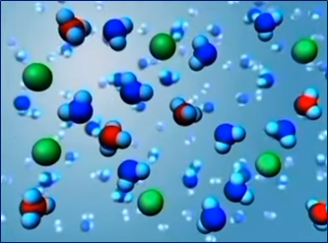
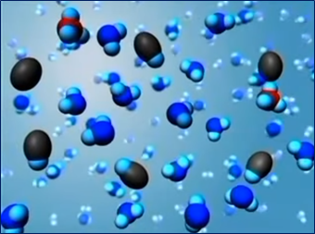
Acid/Base Particulates
Source
Select Acid-Base Ionization
Video
Strong: Since K_{a} = $\frac{\left[H3O˖\right][A˗]}{[HA]}$>>1, at equilibrium strong acids are molecules that essentially ionize to completion in aqueous solution, disassociating into H₃O⁺ ions and the additional anion.
Weak: Since K_{a} = $\frac{\left[H3O˖\right][A˗]}{[HA]}≪$1, at equilibrium weak acids are molecules that only partially ionize in aqueous solution, disassociating into few H₃O⁺ ions and the additional anion.
LO 6.11: The student can generate or use a particulate representation of an acid (strong or weak or polyprotic) and a strong base to explain the species that will have large versus small concentrations at equilibrium.

Slide 52
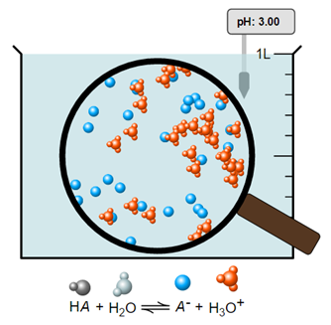
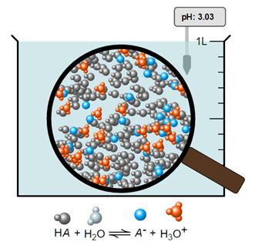
pH of Weak or Strong Acid
Source
Note the similar pH values of both monoprotic acids.
pH= 3.00
pH= 3.00
Video
This is a particulate picture of a weak acid whose [HA] = 1.00M and K_{a} = 1.00x10⁻⁶.
pH is a measure of the [H⁺] in solution. More moles of a weak acid are needed to achieve equivalent [H⁺] values of a strong acid of the same pH, since a weak acid only partially ionizes.
This is a particulate picture of a strong acid whose [HA] = 0.00100M.
Note the 100% ionization of this acid.
If similar volumes of both acids above were titrated with the same strong base, the weak acid would require a larger volume of base to reach its equivalence point.
LO 6.12: Reason about the distinction between strong and weak acid solutions with similar values of pH, including the percent ionization of the acids, the concentrations needed to achieve the same pH, and the amount of base needed to reach the equivalence point in a titration.

Slide 53
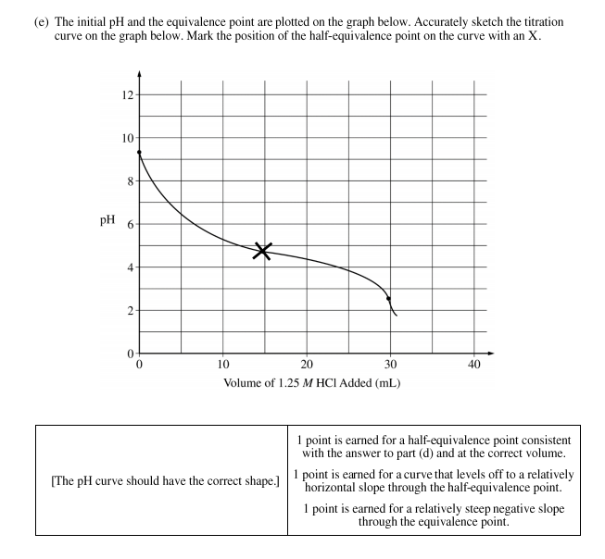
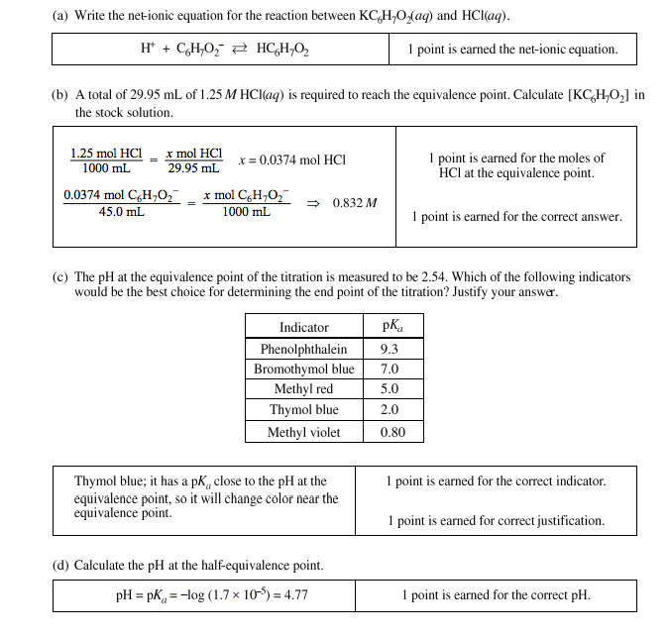
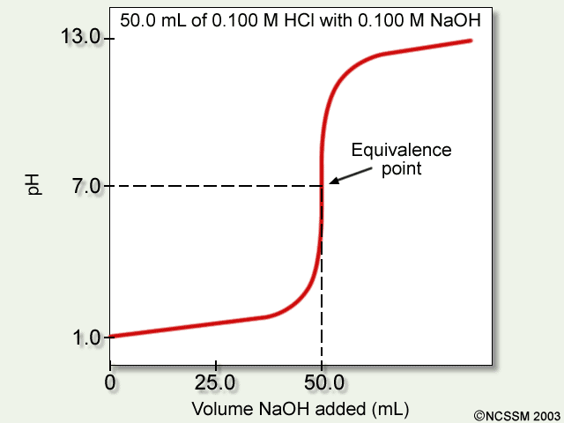
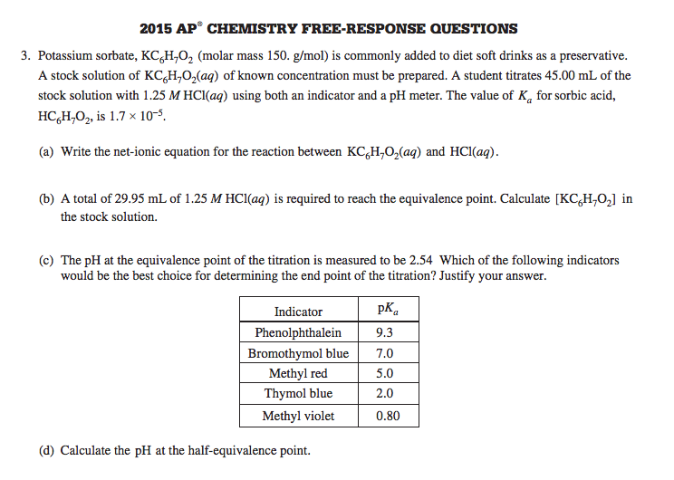
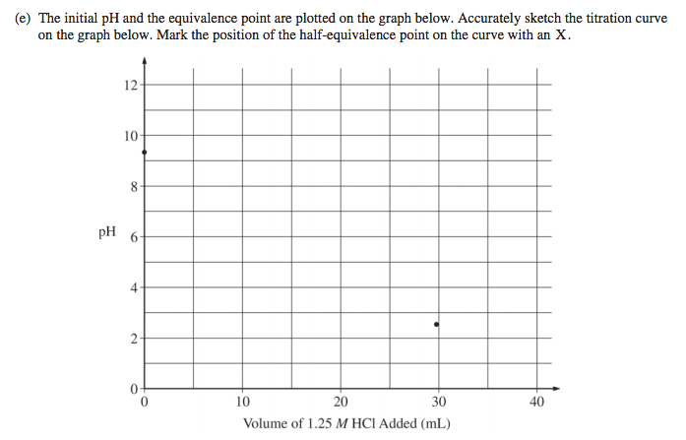
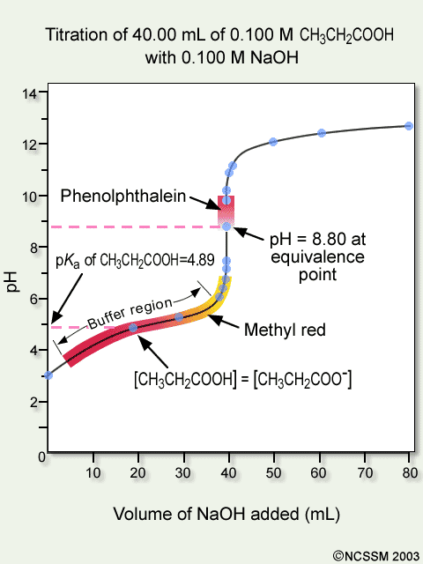
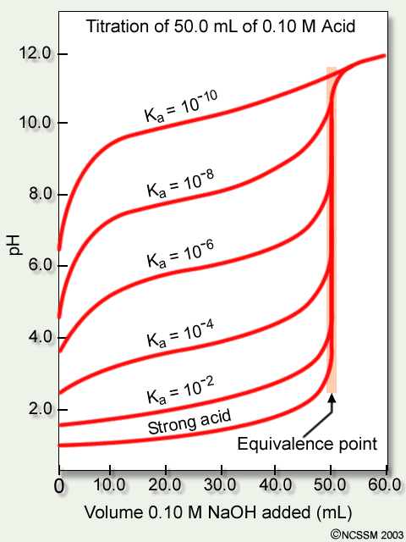
Titrations
Source
This illustration shows the titration curve of a strong acid with a strong base.
Video
This illustration shows the titration curve of a weak acid with a strong base with indicator changes.
This illustration shows the titration curves of several weak acids with a strong base
See Source link to review titration calculations.
This illustration shows the titration curve of a weak base with a strong acid with indicator changes.
This illustration shows the titration curve of a polyprotic weak acid with a strong base.
LO 6.13: The student can interpret titration data for monoprotic or polyprotic acids involving titration of a weak or strong acid by a strong base (or a weak or strong base by a strong acid) to determine the concentration of the titrant and the pK_{a} for a weak acid, or the pK_{b} for a weak base.

Slide 54
K_{w} and Temperature
Source
Video
E +
As T increases, pH of pure water decreases. The water is NOT becoming more acidic. A solution is only acidic if [H+] > [OH-].
At 50°C, the pH of pure water is 6.63, which is defined as “neutral”, when [H⁺] = [OH⁻]. A solution with a pH of 7 at this temperature is slightly basic b/c it is higher than the neutral value of 6.63.
The dissociation of water is endothermic. An increase of energy will shift the reaction to the right, increasing the forward reaction, and increase the value of K_{w}.
LO 6.14: The student can, based on the dependence of K_{w} on temperature, reason that neutrality requires [H⁺] = [OH⁻] as opposed to requiring pH = 7, including especially the application to biological systems.

Slide 55
Acid/Base Mixtures and its pH
Source
A 25 mL sample of hydrofluoric acid (HF) is titrated with 25 mL of 0.30M sodium hydroxide (NaOH). At the equivalence point of the titration, what would the pH of the solution be? Justify with a reaction.
pH < 7
pH = 7
pH > 7
pH = pK_{a}
Video
Click reveals answer and explanation.
The correct answer is “c” pH>7. At the equivalence point, the moles of acid equal the moles of base. The remaining species would be Na⁺ and F⁻. The conjugate base, F⁻ will hydrolyze with water, producing OH⁻ in solution: F⁻(aq) + H₂O(l)  HF(aq) + OH⁻(aq) Select the Source link to see more calculations in this titration.
LO 6.15: The student can identify a given solution as containing a mixture of strong acids and/or bases and calculate or estimate the pH (and concentrations of all chemical species) in the resulting solution.

Slide 56
pH and Acid/Base Equilibria
Source
1st click reveals answer and explanation.
See Source link for more calculations.
1. Vinegar is 0.50M acetic acid, HC₂H₃O_{2,} with a K_{a} = 1.8 x 10⁻⁵. What would be the pH of this solution?
Video
2. Identify and compare the relative strengths of the two acids and the two bases in this neutralization reaction: OH⁻(aq) + NH₄⁺(aq)  H₂O(l) + NH₃(aq).
The correct formulation of acid strength is based on a comparison to the K_{a}'s of hydronium (=1) and water (= 1 x 10⁻¹⁴). Any acid that is stronger than hydronium (e.g. HCl) is a strong acid and its conjugate base (chloride) has no effect on pH because it does not hydrolyze in water. Any acid whose strength is between hydronium and water (e.g. ammonium) is a weak acid, and its conjugate is a weak base. Similarly, for bases, any base with K_{b} greater than that of hydroxide, which is = 1, (e.g., oxide ion as K₂O) is a strong base, and its conjugate acid (K⁺) has no effect on pH because it does not hydrolyze in water. Any base with K_{b} between that of hydroxide and water (= 1 x 10⁻¹⁴) is a weak base, and its conjugate is a weak acid (e.g., acetate).
2nd click reveals answer and explanation.
Answer: Hydroxide(OH⁻), and ammonia(NH₃) are the two bases, with ammonia being the weaker, while ammonium(NH₄⁺) and water are the acids, with water the weaker.
LO 6.16: The student can identify a given solution as being the solution of a monoprotic weak acid or base (including salts in which one ion is a weak acid or base), calculate the pH and concentration of all species in the solution, and/or infer the relative strengths of the weak acids or bases from given equilibrium. concentrations.

Slide 57
Acid/Base reaction species
Source
Ask yourself:
Is it strong? Weak? A salt? A buffer? What will it do in water?
See Source link for more details
Video
Deal w/strong A/B first. These will react to completion with the available species.
LO 6.17: The student can, given an arbitrary mixture of weak and strong acids and bases (including polyprotic systems), determine which species will react strongly with one another (i.e., with K>1) and what species will be present in large concentrations at equilibrium.

Slide 58
How to Build a Buffer:
Source
Estimating Buffer Capacity:
A buffer is only effective as long as it has sufficient amounts of both members of the conjugate acid-base pair to allow equilibrium to shift during a stress.
Getting the pH correct:
The pH of a buffer is primarily determined by the pKa of the weak acid in the conjugate acid-base pair.
When both species in the conjugate acid-base pair have equal concentrations, the pH of the buffer is equal to the pKa.
Choose a conjugate acid-base pair that has a pKa closest to the pH you desire and then adjust concentrations to fine tune from there.
Video
LO 6.18: The student can design a buffer solution with a target pH and buffer capacity by selecting an appropriate conjugate acid-base pair and estimating the concentrations needed to achieve the desired capacity.

Slide 59
Finding the Major Species
Source
A 50.0 mL sample of 0.50 M HC₂H₃O₂ is titrated to the half equivalence point with 25.0 mL of 0.50 M NaOH. Which of the following options shows the correct ranking of the molarities of the species in solution?
(pKa for HC₂H₃O₂ is 4.7)
a. [HC₂H₃O₂] > [C₂H₃O₂ ¹⁻] > [ H⁺ ] > [ OH⁻ ]
b. [HC₂H₃O₂] = [C₂H₃O₂ ¹⁻] > [ H⁺ ] > [ OH⁻ ]
c. [HC₂H₃O₂] > [C₂H₃O₂ ¹⁻] = [ H⁺ ] > [ OH⁻ ]
d. [C₂H₃O₂ ¹⁻] > [HC₂H₃O₂] > [ OH⁻ ] > [ H⁺ ]
Option B is correct.
At the half equivalence point, the concentrations of the weak acid and its conjugate base are equal because the OH⁻ ion has reacted with half of the original acetic acid. The pH of the buffer is equal to the pKa at that point, so the [H+] is 10^{-4.7} which is far lower than the concentrations of the conjugates but far higher than the [OH-] which has a value of 10^{-9.3}.
Video
Click reveals answer and explanation.
LO 6.19: The student can relate the predominant form of a chemical species involving a labile proton (i.e., protonated/deprotonated form of a weak acid) to the pH of a solution and the pKa associated with the labile proton.

Slide 60
The Buffer Mechanism
Source
A buffer is able to resist pH change because the two components (conjugate acid and conjugate base) are both present in appreciable amounts at equilibrium and are able to neutralize small amounts of other acids and bases (in the form of H₃O⁺ and OH⁻) when they are added to the solution. Take, for example, a fluoride buffer made from hydrofluoric acid and NaF. An ideal fluoride buffer would contain equimolar concentrations of HF and NaF. Since they are a weak acid and a weak base, respectively, the amount of hydrolysis is minimal and both buffer species are present at, effectively, their initial supplied concentrations.
Video
If a strong acid is added to the HF/F⁻ buffer, then the the added acid will react completely with the available base, F⁻. This results in a nearly unchanged [H₃O⁺] and a nearly unchanged pH.
H₃O⁺_{(aq)} + F⁻_{(aq)} → HF_{(aq)} + H₂O_{(l)}
If a strong base is added to the HF/F⁻ buffer, then the added base will react completely with the available acid, HF. This results in a nearly unchanged [H₃O⁺] and a nearly unchanged pH.
HF_{(aq)} + OH⁻_{(aq)} → F⁻_{(aq)} + H₂O_{(l)}
The slight shift in pH after challenge is governed by the hydrolysis equilibrium of HF, based on the new HF and F⁻ concentrations:
HF_{(aq)} + H₂O_{(l)} ⇌ F⁻_{(aq)} + H₃O⁺_{(aq)}
LO 6.20: The student can identify a solution as being a buffer solution and explain the buffer mechanism in terms of the reactions that would occur on addition of acid/base.

Slide 61
K_{sp} and Solubility Calculations
Source
Question:
What is the maximum number of moles of AgBr that will fully dissolve in 1.0 L of water, if the Ksp value of silver bromide is 4.0 x 10⁻¹²?
4.0 x 10⁻¹² b. 2.0 x 10⁻¹² c. 4.0 x 10⁻⁶ d. 2.0 x 10⁻⁶
Answer:
The correct answer is “d” 2.0 x 10⁻⁶ . To determine the solubility of AgBr we need to determine the maximum concentrations of Ag+ and Br- that will equal the equilibrium constant. The Ksp equation is
Ksp = [Ag+][Br-] with [Ag+] = [Br-] = X, so to solve for X we need to take the square root of 4.0 x 10⁻¹²
Video
Click reveals answer and explanation.
LO 6.21: The student can predict the solubility of a salt, or rank the solubility of salts,
given the relevant K_{sp} values.

Slide 62
Find a K_{sp} from solubility data
Source
Video
Click reveals answer and explanation.
LO 6.22: The student can interpret data regarding solubility of salts to determine, or
rank, the relevant Ksp values.

Slide 63
Common Ion Effect
Source
The solubility of a sparingly soluble hydroxide can be greatly increased by the addition of an acid. For example, the hydroxide salt Mg(OH)₂ is relatively insoluble in water:
Mg(OH)_{2(s)} ⇌ Mg²⁺_{(aq)} + 2OH⁻_{(aq)} With Ksp=5.61×10⁻¹²
When acid is added to a saturated solution that contains excess solid Mg(OH)₂, the following reaction occurs, removing OH− from solution:
H⁺_{(aq)} + OH⁻_{(aq)}→H₂O_{(l)}
The overall equation for the reaction of Mg(OH)₂ with acid is thus
Mg(OH)_{2(s)} + 2H⁺_{(aq)} ⇌ Mg²⁺_{(aq)} + 2H₂O_{(l}) (18.7.7)
As more acid is added to a suspension of Mg(OH)₂, the equilibrium shown in Equation 18.7.7 is driven to the right, so more Mg(OH)₂ dissolves.
Video
In contrast, the solubility of a sparingly soluble salt may be decreased greatly by the addition of a common ion. For example, if MgCl₂ is added to a saturated Mg(OH)₂ solution, additional Mg(OH)₂ will precipitate out. The additional Mg²⁺ ions will shift the original equilibrium to the left, thus reducing the solubility of the magnesium hydroxide.
LO 6.23: The student can interpret data regarding the relative solubility of salts in terms of factors (common ions, pH) that influence the solubility.

Slide 64
Salt dissolution: ∆H and ∆S
Source
The enthalpy (∆H_{soln}) of dissolution is dependent upon the intermolecular forces of the solute and solvent.
Video
Java Tutorial
The entropy (∆S_{soln}) of dissolution generally increases the disorder of the system.
LO 6.24: The student can analyze the enthalpic and entropic changes associated with the dissolution of a salt, using particulate level interactions and representations.

Slide 65
K, ∆G° and thermodynamic favorability
Source
G°_{reactants}
Video
∆G°rxn <0
Q=1,
m = ∆G
G°_{products}
Extent of Reaction
The key to understanding the relationship between ∆G° and K is recognizing that the magnitude of ∆G° tells us how far the standard-state is from equilibrium. The smaller the value of ∆G° , the closer the standard-state is to equilibrium. The larger the value of ∆G°, the further the reaction has to go to reach equilibrium.
LO 6.25: The student is able to express the equilibrium constant in terms of ∆G ° and RT and use this relationship to estimate the magnitude of K and, consequently, the thermodynamic favorability of the process.

Slide 66
Now…
Just for Fun Some “Harry” Problems

Slide 67
2Fe(OH)₃ (s) + 3H₂SO₄ (aq) à Fe₂(SO₄)₃ (aq) + 6H₂O (l)
a. Ron Weasley had to perform the above reaction in Professor Snape’s potions class. Ron mixed 45.0 g iron III hydroxide with 45.0 ml 2.00 M sulfuric acid in a cauldron, leaving the lid off. The heat capacity of his cauldron was 645 J/K.
i. What other information would Ron need to know or measure experimentally to determine the molar change in enthalpy of the reaction, ∆H°rxn?
ii. Unbeknownst to Ron, Draco Malfoy dropped a 100 g sneakoscope (assume this is unreactive and at room temperature) into Ron’s cauldron before Ron measured his temperature but after the reaction was initiated. Explain in which direction this would alter Ron’s experimental value of ∆H°rxn.
b. Hermione Granger also performed this reaction. She mixed 45.0 g iron III hydroxide with 450 ml 2.00 M sulfuric acid in her cauldron, and kept the lid on, using a spell to enable her to measure temperature (revelio thermo).
i. How would you expect her temperature change to differ from Ron’s, if at all? For this comparison, assume that Ron’s reaction was performed with the lid on and with no sneakoscope.
ii. Hermione repeated the experiment using all the same measurements, but used aluminum hydroxide instead of iron III hydroxide. Assuming that both reactions have the same ∆H°rxn, would her temperature change be smaller, the same, or greater in her second experiment.
c. Given the following values for absolute entropies, what would ∆S°rxn be?

Slide 68
Just for Fun… Answers
ai. q_{rxn} = -(C_{cal}∆T + c_{(mixture)}m_{(mixture)}∆T); ∆H°rxn = q_{rxn} / moles rxn
Ron would need to measure the starting and final temperatures, know (or measure) the specific heat capacity and mass of the reaction mixture, and the number of moles of reaction. In this case,
45.0 g Fe(OH)₃ / 106.8 g/mole = 0.421 moles; 0.045 L x 2 M = 0.09 moles H₂SO₄ (limiting), so 0.03 moles reaction (to those who dislike this concept, I apologize).
bii. 45.0 g Al(OH)₃ / 78 g/mole = 0.577 mole. This is still limiting, but now there are about 0.288 moles of reaction, so more heat is produced. As the total mass doesn’t change, and the specific heat capacity is unlikely to change dramatically, it is reasonable to predict that ∆T would be larger.
aii. Because the sneakoscope would absorb heat, ∆T would be lower, so the heat of the reaction would appear to be lower as would ∆H°rxn.
c. ∆S°rxn = sum product S° - sum reactant S°
∆S°rxn = 6(69.91) + 2(-315.9) + 3(20.1) – 2(107) – 3(20.08) = -426.3 J/mole*K.
bi. For Hermione, the Fe(OH)₃ is now limiting, as there are now 0.9 moles H₂SO₄. So, there are more moles of reaction, about 0.21, a seven-fold increase. This would increase the temperature change. However, there is also a significant increase in mass of the reaction mixture, from about 90 g to 500 g. This would decrease the temperature change. So the exact ∆T outcome, increase or decrease, depends on the specific heat capacity of the reaction mixture.

Slide 69
2016 Free Response Question #1
A student investigates the enthalpy of solution, ∆H_{soln}, for two alkali metal halides, LiCl and NaCl. In addition to the salts, the student has access to a calorimeter, a balance with a precision of +0.1 g, and a thermometer with a precision of +0.1 °C.
a). To measure ∆H_{soln} for LICl, the student adds 100.0 g of water initially at 15.0 °C to a calorimeter and adds 10.0 g of LiCl (s) stirring to dissolve. After the LiCl dissolves completely, the maximum temperature reached by the solution is 35.6 °C.
i) Calculate the magnitude of the heat absorbed by the solution during the dissolution process, assuming that the specific heat capacity of the solution is 4.18 J/g°C. Include units with your answer.
Released answer: 2 pts; 1 for correct setup, 1 for answer with units. q = mc∆T = (110.0)(4.18)(35.6-15.0) = 9,470 J = 9.47 kJ
Additional comments: Had to use 110 g, not 100 g. If 100 g was used, correct calculation could earn the second pt. Inserting a negative sign or wrong/unshown units cost one pt.

Slide 70
2016 Free Response Question #1
aii) Determine the value of ∆H_{soln} for LiCl in kJ/mol_{rxn}.
Released answer: 2 pts. 10.0g x 1 mol/42.39 g = 0.236 mol LiCl
-9.47 kJ/0.236 mol = -40.1 kJ/mol_{rxn}. 1 pt for correct number of moles, 1 pt for correct ∆H with the correct sign.
Additional comments: correct setup of mole calculation earned the point even if the answer wasn’t shown.
Again, carrying over number from first part correctly would earn credit. Many students did not give the negative sign in the answer, losing credit.

Slide 71
2016 Free Response Question #1
To explain why ∆H_{soln} for NaCl is different than that for LiCl, the student investigates factors that affect ∆H_{soln} and finds that ionic radius and lattice enthalpy (which can be defined as the ∆H associated with the separation of a solid crystal into gaseous ions) contribute to the process. The student consults references and collects the data shown: Li⁺ 76 pm ionic radius; Na⁺ 102 pm ionic radius.
b. Write the complete electron configuration for the Na⁺ ion in the ground state.
Released answer: 1 pt for complete correct configuration. 1s²2s²2p⁶
Additional information: Had to be complete (no noble gas symbol); could not be an orbital diagram unless the configuration information was also present. Way too many students gave us the configuration for the sodium atom, not ion.

Slide 72
2016 Free Response Question #1
c) Using principles of atomic structure, explain why the Na⁺ ion is larger than the Li⁺ ion.
Released answer: 1 pt. The valence electrons in the Na⁺ ion are in a higher principal energy level than the valence electrons in the Li⁺ ion. Electrons in higher principal energy levels are, on average, farther from the nucleus.
Additional information: we wanted to see some sense of occupied principal energy levels being different (saying ‘more’ was no good – no sense of occupancy here, but ‘one extra’ was) (levels or shells, not orbitals or sublevels; 2p is higher energy than 2s, but closer to nucleus on average). For group trends, the best explanation is that higher principal energy levels are occupied, which are further from the nucleus. Many students wanted to talk about shielding, which is more useful for periodic trend reasoning. There is an effect of shielding, but it serves largely to cancel out the increased nuclear charge, so that Zeff (which was also frequently referred to) is largely unchanged.

Slide 73
2016 Free Response Question #1
d) Which salt, LiCl or NaCl, has the greater lattice enthalpy? Justify your answer.
Released answer: 1 pt. LiCl. Because the Li⁺ ion is smaller than the Na⁺ ion, the columbic attractions between ions in the LiCl are stronger than in NaCl, resulting in greater lattice energy.
Additional information: We wanted some discussion about since Li⁺ is smaller, it and Cl⁻ can get closer, and therefore have a stronger attraction. Many students got into Coulombic attraction conversation here, which could work, but it had to be between Li⁺ and Cl⁻ as opposed to between the lithium nucleus and its electrons. Students also frequently referred to electronegativity and ionization energies, which did not earn credit.

Slide 74
2016 Free Response Question #1
e) In the representation of a portion of a crystal of LiCl, identify the ions by writing in the appropriate formulas (Li⁺ or Cl⁻) in the boxes.
Released answer: 1 pt. The larger ion is Cl⁻, the smaller is Li⁺.
Additional information: Not much to say here, there were only two choices, but many students apparently didn't realize that losing or gaining electrons alters the size of the entity.

Slide 75
2016 Free Response Question #1
f) The lattice enthalpy of LiCl is positive, indicating that it takes energy to break the ions apart in LiCl. However, the dissolution of LiCl in water is an exothermic process. Identify all particle-particle interactions that contribute significantly to the dissolution process being exothermic. For each interaction, include the particles that interact and the specific type of intermolecular force between those particles.
Released answer: There are interactions between Li⁺ ions and polar water molecules and between Cl⁻ ions and polar water molecules. These are ion-dipole interactions. 1 pt for identifying the particles that interact, 1 pt for identifying the type of interaction.
Additional information: The first point was for naming the three particles involved in the exothermic processes: H₂O with Li⁺, and H₂O with Cl⁻. Showing H⁺ or OH⁻ or O⁻² lost this point. The second point was for ion-dipole attraction. We did accept a thorough description of an ion-dipole attraction in the absence of that specific phrase which could’ve included a diagram. Again, any reference to water ions (such as ‘the H⁺ of water) lost the point; however, partial charge was good. Many students invoked LDF, which as they were quick to point out, are always present. However, it was also irrelevant to the question. Mentioning dipole-dipole lost the point.

Slide 76
Common Problems and Misconceptions
Going from mass to empirical formula – often switch the coefficients
Transition metals lose the s electrons first
s electrons are further on average from nucleus than p for same energy level
Units: kJ vs J, °C vs K, per mole or per gram; don’t lose track of which unit you’re using; not always at STP for a gas
Explaining is more than just an observation: a lone pair on a central atom is not sufficient for shape, the pair must act (repel the other electrons)
What occurs in the process of dissolving? The solute is not disappearing; it is mixing
Notes:
Show combustion analysis slide for Big Idea #1
Van der Waal’s is not LDF; mass is not an explanation for LDF, # electrons, polarizability, size, volume have been accepted
Students get mixed up in limiting reactant problems – amounts of whatever is left over
Don’t make H+ from a strong base, don’t make OH- from a strong acid

Slide 77
Common Problems and Misconceptions
Don’t make H⁺ from the addition of a strong base; don’t make OH⁻ from the addition of a strong acid
Van der Waal’s is not LDF; do not use mass as an explanation for LDF. You may use polarizability, # of electrons, size, and volume.
Limiting reactant problems are confusing – which is limiting, how much of the other is used up, how much of the other remains, etc
Combustion analysis to get empirical formula can be confusing, particularly if not using oxygen as the oxidizer

Slide 78
Science Practices
Laboratory Exercises

Slide 79
Gravimetric Analysis
Source
What It Determines:
amount of analyte by mass measurements
% composition
empirical formulas
How It Can Be Done:
Dehydration of a hydrate
Forming a precipitate, which is then isolated and massed
Analysis:
Remember to ALWAYS go to moles!
use mole ratios to convert between various components
Video
Virtual Lab
Possible Source of Error | Contamination in solid | Incomplete Precipitation | Solid not fully dehydrated
Impact on Results | measured mass too large | Lose ion in filtrate – mass too small | measured mass too large
Science Practices
1.5 The student can re-express key elements of natural phenomena across multiple representations in the domain.
2.2 The student can apply mathematical routines to quantities that describe natural phenomena.
4.2 The student can design a plan for collecting data to answer a particular scientific question.
5.1 The student can analyze data to identify patterns or relationships.
6.1 The student can justify claims with evidence.
Learning Objectives
1.3: The student is able to select and apply mathematical relationships to mass data in order to justify a claim regarding the identity and/or estimated purity of a substance.
1.17: The student is able to express the law of conservation of mass quantitatively and qualitatively using symbolic representations and particulate drawings.
1.19: The student can design, and/or interpret data from, an experiment that uses gravimetric analysis to determine the concentration of an analyte in a solution.

Slide 80
Gas Laws Labs
After rxn, eudiometer lowered into water until levels equal so pressure inside room and tube are same
Use Dalton’s Law to subtract P_{water}
Sources of error:
Mg left: moles of H₂ too low
Air bubble at start: volume of gas too high
Source 1
Determination of Molar Mass of a Volatile Liquid
How It’s Done/Analysis:
Volatile liquid heated until completely vaporized
PV=nRT to solve for n:
Temperature of water bath=T
Small hole in stopper means Pressure = room pressure
Volume=volume of flask
Divide Mass of recondensed unknown by moles, compare to known molar mass to ID unknown
Assume vapor completely recondenses
→If lose vapor, then mass would be too low, and moles would be low
Determination of Molar Volume of a Gas
Source 2
Video 1
Video 2
Video 3
http://chemskills.com/?q=ideal_gas_law
Diffusion : Graham’s Law
Demo
How It’s Done/Analysis:
Ends of glass tube plugged with soaked cotton
White ring is NH₄Cl ppt
Ppt will not be exactly in middle…
Molar mass of NH₃ is lower than MM of HCl, so ring will be toward right side of tube
Graham’s Law can be used to establish ratios which can be applied to distances
Science Practices
1.4 The student can use representations and models to analyze situations or solve problems qualitatively and quantitatively.
2.2 The student can apply mathematical routines to quantities that describe natural phenomena.
2.3 The student can estimate numerically quantities that describe natural phenomena.
6.4 The student can make claims and predictions about natural phenomena based on scientific theories and models.
Learning Objectives
LO 2.4: The student is able to use KMT and concepts of intermolecular forces to make predictions about the macroscopic properties of gases, including both ideal and nonideal behaviors.
LO 2.6: The student can apply mathematical relationships or estimation to determine macroscopic variables for ideal gases.

Slide 81
Chromatography
Click here to watch animation explaining column chromatography
Source
Video
Virtual Lab
Source (includes nice discussion of biological applications)
Main Error:
Incomplete Separation
Can be caused by:
Inconsistent spotting
Overloading
Improper packing (column)
Poor solvent choice
Advantage: We can collect and use the fractions
Science Practices
4.2 The student can design a plan for collecting data to answer a particular scientific question.
5.1The student can analyze data to identify patterns or relationships.
6.2 The student can construct explanations of phenomena based on evidence produced through scientific practices.
Learning Objectives
LO 2.7: The student is able to explain how solutes can be separated by chromatography based on intermolecular interactions.
LO 2.10: The student can design and/or interpret the results of a separation experiment (filtration, paper chromatography, column chromatography, or distillation) in terms of the relative strength of interactions among and between the components.

Slide 82
Synthesis
Source
Inorganic Synthesis Examples:
Synthesis of Coordination Compound
Synthesis of Alum from aluminum
Organic Synthesis Example:
Synthesis of Aspirin
Syntheses are done in solution, and require purification by filtration, recrystalization, column chromatography or a combination
% Yield is calculated; analysis is done by melting point, NMR, IR
Video
Virtual Lab
Synthesizing Alum Procedure:
Source of aluminum is reacted with KOH
Possible Error Sources: impurity in Al (such as plastic coating) prevents complete rxn
H₂SO₄ is added to ppt Al(OH)₃
Possible Error Sources: incomplete precipitation
Mixture heated until no Al(s) is left
Possible Error Sources: some Al(s) remains undissolved
Filter and collect alum crystals
Possible Error Sources: crystals escape to filtrate, crystals not washed well and remain wet
Recrystallize alum in ice bath
Possible Error Sources: crystals form too quickly, incomplete recrystallization
Science Practices
2.1 The student can justify the selection of a mathematical routine to solve problems.
2.2 The student can apply mathematical routines to quantities that describe natural phenomena.
4.2 The student can design a plan for collecting data to answer a particular scientific question.
6.1 The student can justify claims with evidence.
Learning Objectives
LO 3.5: The student is able to design a plan in order to collect data on the synthesis or decomposition of a compound to confirm the conservation of matter and the law of definite proportions.
LO 3.6: The student is able to use data from synthesis or decomposition of a compound to confirm the conservation of matter and the law of definite proportions.
LO:

Slide 83
Titration- Acid/Base
Source 1
Assumption: Endpoint is equivalence point
This is not true – we actually “overshoot” before indicator changes
Possible Sources of Error:
Overshoot Endpoint
Moles of titrant (and therefore analyte) too high
Not reading to bottom of meniscus
Moles of titrant too low
Concentration of titrant not what expected
Be sure to rinse buret with titrant first to control for this
Source 2
Video
Source
Virtual Lab
Strength of Acids affects shape of graph:
Polyprotic acids have multiple end points:
Science Practices
1.4 The student can use representations and models to analyze situations or solve problems qualitatively and quantitatively.
5.1 The student can analyze data to identify patterns or relationships.
Learning Objectives
LO 6.12: The student can reason about the distinction between strong and weak acid solutions with similar values of pH, including the percent ionization of the acids, the concentrations needed to achieve the same pH, and the amount of base needed to reach the equivalence point in a titration.
LO 6.13: The student can interpret titration data for monoprotic or polyprotic acids involving titration of a weak or strong acid by a strong base (or a weak or strong base by a strong acid) to determine the concentration of the titrant and the pKa for a weak acid, or the pKb for a weak base.

Slide 84
REDOX Titration
Source 1
Endpoint can be determined by potentiometer:
Or REDOX indicator:
Applications/Methods of REDOX Titrations:
Or an indicator that shows the presence of a particular species:
Vitamin C Content
Concentration of a redox species
Back Titrations
Video
Virtual Lab
Source
Starch indicates presence of iodine
Source
Source
Done when the endpoint can be hard to ID – add an excess, and then back titrate to determine how much is in excess
Science Practices
4.2 The student can design a plan for collecting data to answer a particular scientific question.
5.1 The student can analyze data to identify patterns or relationships.
Learning Objectives
LO 1.20: The student can design, and/or interpret data from, an experiment that uses titration to determine the concentration of an analyte in a solution.
LO 3.9: The student is able to design and/or interpret the results of an experiment involving a redox titration.

Slide 85
Kinetics
Virtual Lab 1
Virtual Lab 2
Video
Source 1
Using Spectrometry:
Data:
Analysis
rate law from straight-line graph
k from integrated rate law
E_{a} from Arrhenius Equation
Clock Reactions
Reactions that have a delayed physical change due to mechanism which only has a later step show color change
Concentration vs. time data can be gathered
It is important that there is a relatively low [S₂O₃⁻] so that the I₃⁻ will accumulate and show the color change
Time (s)
Zero Order Plot | 1st Order Plot | 2nd Order Plot
Blue in the presence of starch
Science Practices
2.1 The student can justify the selection of a mathematical routine to solve problems.
2.2 The student can apply mathematical routines to quantities that describe natural phenomena.
5.1 The student can analyze data to identify patterns or relationships.
Learning Objectives
LO 4.2: The student is able to analyze concentration vs. time data to determine the rate law for a zeroth-, first-, or second-order reaction.
LO 4.3: The student is able to connect the half-life of a reaction to the rate constant of a first-order reaction and justify the use of this relation in terms of the reaction being a first-order reaction.

Slide 86
Calorimetry
Application of Law of Conservation of Energy: All heat produced/consumed during reaction (system) is exchanged with the surroundings.
Source 1
Applications:
Coffee Cup Calorimeter
Assumption:
the calorimeter is isolated
so the surroundings are only the calorimeter setup, which includes the water
the calorimeter itself has a heat capacity, as it will absorb some heat.
So…
q_{surr} = -q_{rxn}
q_{surr} = q_{cal}+q_{H2O+sys}
q_{cal} = CcalΔT
Therefore:
-q_{rxn}= C_{cal}ΔT + m_{H2O+sys}cΔT
Then we can use q_{rxn} find ΔH_{rxn}:
ΔH_{rxn} =q_{rxn}/mol_{react}
Specific Heat of Material
Can be used to ID unknown
Heat of reaction
Energy content of food
This is usually done in a bomb calorimeter (constant V)
Video
Virtual Lab
Constant P
Source
Source
Science Practices
1.4 The student can use representations and models to analyze situations or solve problems qualitatively and quantitatively.
2.2 The student can apply mathematical routines to quantities that describe natural phenomena.
4.2 The student can design a plan for collecting data to answer a particular scientific question.
5.1 The student can analyze data to identify patterns or relationships.
Learning Objectives
LO 5.4: The student is able to use conservation of energy to relate the magnitudes of the energy changes occurring in two or more interacting systems, including identification of the systems, the type (heat versus work), or the direction of energy flow.
LO 5.7: The student is able to design and/or interpret the results of an experiment in which calorimetry is used to determine the change in enthalpy of a chemical process (heating/cooling, phase transition, or chemical reaction) at constant pressure.

Slide 87
Qualitative Analysis
Virtual Lab 1
Virtual Lab 2
Video
Source
Remember that the lower the K_{sp}, the less soluble the substance. Qualitative analysis then also allows a ranking of salts by K_{sp}, and demonstrates the effect of pH on solubility.
Science Practices
2.2 The student can apply mathematical routines to quantities that describe natural phenomena.
2.3 The student can estimate numerically quantities that describe natural phenomena.
5.1 The student can analyze data to identify patterns or relationships.
6.4 The student can make claims and predictions about natural phenomena based on scientific theories and models.
Learning Objectives
LO 6.21: The student can predict the solubility of a salt, or rank the solubility of salts, given the relevant Ksp values.
LO 6.22: The student can interpret data regarding solubility of salts to determine, or rank, the relevant Ksp values.
LO 6.23: The student can interpret data regarding the relative solubility of salts in terms of factors (common ions, pH) that influence the solubility.

Slide 88
Write This, Not That
Write This… | …Not That! | Rationale
Generally
The language used in the question when asked to make a choice (ex: “increases”, “decreases”, etc.) | Other words that may mean the same thing but are likely more ambiguous (ex: “goes up”, “goes down”, etc.) | Make it easy to give you points, and be sure the reader can understand what you saying
Answer the specific question first, then “justify”, “explain” etc. | Burying the answer in the text of the response | Make it easy to give you points
names of specific elements and compounds, “reactants”, “products”, etc. | “it” | Ambiguous
“Species” | “It”, “stuff”, etc. | Be formal in language
A justification or explanation when it is part of the question | Only the answer without supporting it | Justification/explanation required to earn point
“mass”, “volume”, etc. | “size” | Be specific
References to specific data or graphs when prompted to “explain how the data…” or something similar | Make generalizations about the data without specifically citing provided data or trials | Required to earn point
Net ionic equations only containing species that change | Aqueous ionic compounds in their undissociated form, spectator ions | Including these is not a net ionic, it’s a molecular or complete ionic
Particle view diagrams with ions and polar molecules orientated in the correct direction relative to each other | Incorrectly oriented dipoles | Drawings must demonstrate understanding of interactions at the molecular level (ref. 2015 #4)
An answer with units if “include units” is stated in the problem | An answer without units | If “include units” is written in the prompt, a unit is required to earn full points
Show all work used to derive an answer | An answer without supporting work shown | Work is often what earns some/all of the points
Answers expressed to the correct number of significant figures | Answers with an incorrect number of significant figures | 1 pt traditionally is assessed somewhere in the FR for significant figures.

Slide 89
Write This… | …Not That! | Rationale
Gases
Components of the Kinetic Molecular Theory as justifications for changes at the molecular level | Ideal gas law for molecular level justification | arguments based on PV = nRT are at the bulk level and not the molecular level (ref. 2013 #5)
Thermodynamics
Values with correct signs | Values with incorrect signs | Necessary for correct calculations and determinations – watch signs based on bonds breaking/forming, heat flow in calorimetry indicated by temperature changes, signs that may change in application of Hess’ Law, etc.
Kinetics
Value of k with units | Value of k without units | Units required to earn point
Specific parts of the molecules that must collide in order for the reaction to occur | “Collision must occur in the correct orientation” | AP wants more specific answer
A rate law that includes the rate constant k as part of it | A rate law without k being included | Incomplete rate law if k is not included
A rate law based only on reactants | A rate law that includes products | Rate laws are based only on reactants
Equilibrium
Discussion of Q vs. K | “reduce the stress”, or “due to Le Châtelier’s Principle” | Preferred AP language
“Proceeds” | “Shift” – if equilibrium has not yet been established (i.e. a precipitate has not yet been formed when evaluating K_{sp}) | If equilibrium is not yet established, then it cannot “shift” – rxn will proceed in a certain direction until equilibrium is established
K_{sp} expressions that only contain the ions | K_{sp} expressions that contain or imply a species in the denominator | Solids and liquids are not included in equilibrium expressions
Correct formulas (including charges!) for all species in equilibrium expressions | Substitutions, abbreviations, chargeless ions, other shorthand that may work out in calculations but does not represent the correct species | Equilibrium expressions must be written formally when requested
In K_{p} expressions: P_{species} | In K_{p} expressions: [species] | Concentration is not used in K_{p}, partial pressures are
“x has been assumed to be so small relative to the original concentrations that it can be ignored” | Nothing about why you ignore x to avoid quadratics | Show you understand why you are making the decision

Slide 90
Write This, Not That continued
Write This… | …Not That! | Rationale
Acids and Bases
“The pH > 7 because the salt produced in the neutralization behaves as a base: A⁻ + H₂O HA + OH⁻ ” | “The pH > 7 because it’s a battle between weak acid and strong base and strong base wins.” | State the actual reason not the memory aid
“The solution is neutral when [H₃O⁺] = [OH⁻].” | “The solution is neutral when pH=7.” | True definition of neutral – neutral is only pH of 7 when K_{w} = 1.0 x 10⁻¹⁴ (at 298 K)
K_{w} = K_{a} x K_{b} for a conjugate pair | K_{w} = K_{a} x K_{b} for an unrelated acid/base pair | This equation only holds true for conjugate acid-base pairs
pH = pKa because it is at ½ the equivalence point of a titration of a weak acid with a strong base | pH = pKa | Explains the reason behind this, and shows you understand this is only true at this point
Atomic Structure
“Effective nuclear charge increases” | “It wants to have a full octet”; “it’s close to having a full octet” | State the actual reason not the memory aid
“It has a more polarizable cloud of electrons” | “It has more electrons”, “it has more mass”, “it has more surface area”, “it is bigger”, “it has more protons” | This is the shortest way to show the reason – simply mentioning “more” of something is probably not enough to demonstrate without further explanation of why that is the case
“period” | “shell” when referring to elements and their location on the Periodic Table | Elements are in a period, electrons are in a shell
Reference reasons for periodic trends (i.e. effective nuclear charge, coulomb’s law, polarizability, etc.) | Stating the trend as the reason (“because it is to the left”, “because it is further down the periodic table”, etc.) | State the actual reason not the memory aid
“Electrons in higher energy levels are farther from the nucleus, resulting in a larger atom/ion.” | “More electrons/more energy levels make the atom/ion bigger.” | Explanation of reason, not just statement of fact, required for point (Ref 2016 #1)

Slide 91
Write This… | …Not That! | Rationale
Bonding and Intermolecular Forces
“Overcome intermolecular forces” | “break up” a solid/liquid | IMFs should be used to justify
Ion interactions | LDF’s when discussing ionic compounds | Ionic compounds have ions with whole charges, which dominate interactions
“Coulombic attraction” | “Opposites attract” | State the actual reason not the memory aid
Describe the process of overcoming intermolecular forces/polarity | “Like dissolves like” | State the actual reason not the memory aid
“Has hydrogen bonds between the molecules” | “Has hydrogen bonds” | Shows that you understand hydrogen bonds are not actually bonds
“ionic compound” | “molecule” when discussing an ionic compound | A molecule is a covalent compound
“ions” | “atoms” when discussing ionic compounds | Ionic compounds contain ions
“atoms” | “ions” when discussing covalent compounds | Covalent compounds do not contain ions
Lewis structures that are complete with necessary lone pairs and/or resonance | Lewis structures that are missing lone pairs and/or resonance (if needed for correct structures) | Lewis structures are incorrect without necessary lone pairs
Identify specific intermolecular forces at play | “stronger intermolecular forces” | Shows your understanding of the chemistry at play
“dissolve” when discussing interactions between molecular substances in solution | “ionize”, “dissociate”, “bond”, “react”, “attack”, “break up”, etc. | Molecular substances do not dissociate into ions, dissolving is not reacting, and otherwise be formal in usage
Electrochemistry
Loss of mass of electrode is due to atoms of electrode going into solution as ions | Loss of mass of electrode is due to loss of electrons | Electrons have extremely small (negligible in this case) mass (ref. 2014 #3)
Discussion of Q vs. K for changes in cell potential after a change, or qualitative discussion of Nernst Equation | Discussion of Le Châtelier’s principle | Preferred AP language (ref. 2014 #3)

