Slide 1
Big Idea #3
Chemical Reactions

Slide 2
Changes in matter involve the rearrangement and/or reorganizations of atoms and/or the transfer of electrons.

Slide 3
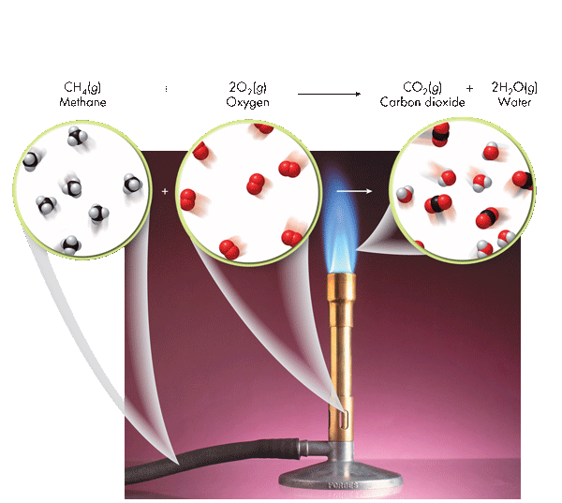
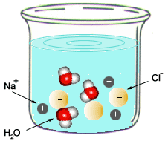
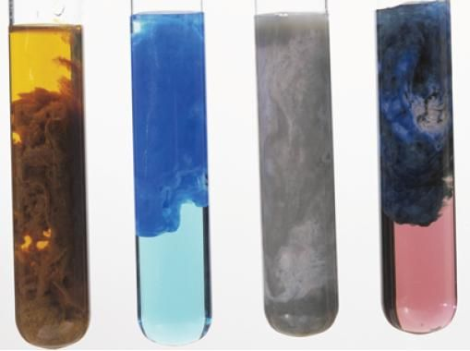
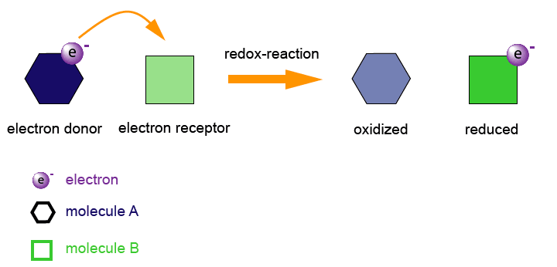
Types of Chemical Reactions
Source
Combustion
C_{x}H_{x} + O₂ → CO₂ + H₂O
Acid-Base (Neutralization)
HA + BOH → H₂O + BA
Video
C. Pearson Chemistry. Boston, MA: Pearson, 2012. Print.
Oxidation-Reduction
A ⁺ + e⁻ → A
B → B + e⁻
Precipitation
AB (aq) + CD (aq)→ AD (aq) + CB (s)
LO 3.1: Students can translate among macroscopic observations of change, chemical equations, and particle views.

Slide 4
Types of Chemical Reactions
Source
Combustion
C_{x}H_{x} + O₂ → CO₂ + H₂O
Acid-Base (Neutralization)
HA + BOH → H₂O + BA
Video
C. Pearson Chemistry. Boston, MA: Pearson, 2012. Print.
Oxidation-Reduction
A ⁺ + e⁻ → A
B → B + e⁻
Precipitation
AB (aq) + CD (aq)→ AD (aq) + CB (s)
LO 3.1: Students can translate among macroscopic observations of change, chemical equations, and particle views.

Slide 5
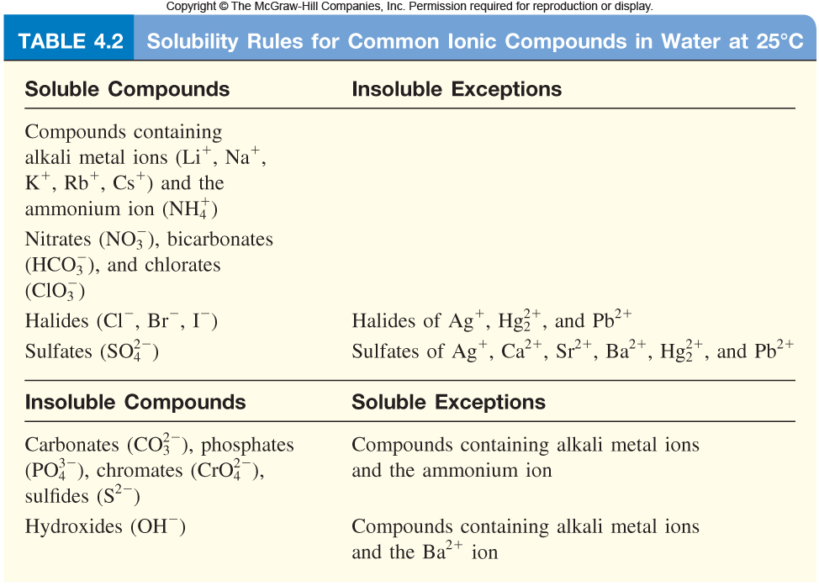
Balanced Equations
Source
Complete Molecular: | AgNO₃ (aq) + KCl (aq) ⎯→ AgCl (s) + KNO₃ (aq)
Complete Ionic : | Ag⁺(aq) + NO₃⁻(aq) + K⁺(aq) + Cl⁻(aq) ⎯→ AgCl (s) + K⁺(aq) + NO₃⁻(aq)
Net Ionic : | Ag⁺(aq) + Cl⁻(aq) ⎯→ AgCl (s)
Video
Quizlet
Spectator ions should not be included in your balanced equations.
Remember, the point of a Net Ionic Reaction is to show only those ions that are involved in the reaction. Chemists are able to substitute reactants containing the same species to create the intended product.
You only need to memorize that compounds with nitrate, ammonium, halides and alkali metals are soluble.
LO 3.2: The student can translate an observed chemical change into a balanced chemical equation and justify the choice of equation type (molecular, ionic, or net ionic) in terms of utility for the given circumstances.

Slide 6
Making Predictions
Source
Solid copper carbonate is heated strongly:
CuCO₃ (s) → CuO (s) + CO₂ (g)
What evidence of a chemical change would be observed with this reaction?
One would observe a color change and evolution of a gas
What is the percent yield of CO₂ if you had originally heated 10.0g CuCO₃ and captured 3.2g CO₂ ?
Step 1: Find the Theoretical Yeild
10.0g CuCO₃ x(1mol/123.555g) x (1mol CO₂ /1 molCuCO₃ ) X 44.01gCO₂/mol = 3.562 gCO₂
Step 2: Find Percent Yield
(3.2 g / 3.562 g) * 100 = 89.8 % → 90% with correct sig figs
How could you improve your percent yield?
-reheat the solid, to see if there is any further mass loss
-make sure you have pure CuCO₃
Click reveals answer and explanation.
Video
Click reveals answer and explanation.
Click reveals answer and explanation.
Click reveals answer and explanation.
LO 3.3: The student is able to use stoichiometric calculations to predict the results of performing a reaction in the laboratory and/or to analyze deviations from the expected results.

Slide 7
Limiting Reactants – D.A.
Source
Al₂S₃ + 6 H₂O ---> 2Al(OH)₃ + 3 H₂S
15.00 g aluminum sulfide and 10.00 g water react
Identify the Limiting Reactant
Video
Sim
pHet
Click reveals answer and explanation.
15.00g Al₂S₃ x (1mol/ 150.158 g) x (6mol H₂O/1mol Al₂S₃) x (18g/mol H₂0 ) = 10.782 g H₂0 needed
10g H₂0 x (1mol/ 18.015 g) x (1 mol Al₂S₃ / 6mol H₂O) x (150.158 g/mol) = 13.892g Al₂S₃ needed
H₂0 is limiting, because we need more than we were given
b) What is the maximum mass of H₂S which can be formed from these reagents?
Theoretical Yield
10.00 g H₂0 x (1mol/ 18.015 g) x (3/6) x (34.0809 g/mol ) = 9.459 g H₂S produced
Click reveals answer and explanation.
c) How much excess reactant is left in the container?
Click reveals answer and explanation.
15.00 g – 13.892 g = 1.11g Al₂S₃
**Dimensional Analysis is not the only way to solve these problems. You can also use BCA tables (modified ICE charts), which may save time on the exam →
LO 3.4: The student is able to relate quantities (measured mass of substances, volumes of solutions, or volumes and pressures of gases) to identify stoichiometric relationships for a reaction, including situations involving limiting reactants and situations in which the reaction has not gone to completion.

Slide 8
Limiting Reactants – BCA Table
Source
15.00 g aluminum sulfide and 10.00 g water react according to the following equation:
Al₂S₃ + 6 H₂O ---> 2Al(OH)₃ + 3 H₂S
Identify the Limiting Reactant
Video
Click reveals answer and explanation.
15.00g Al₂S₃ x (1mol/ 150.158 g) = .100mol
10g H₂0 x (1mol/ 18.015 g) = .555
Water is the limiting reactant.
 | Al₂S₃ | 6 H₂O | 2Al(OH)₃ | 3 H₂S
Before | .0999 | .5551 | 0 | 0
Change | -.0925 | -.5551 | + .1850 | + .2775
After | .0074 | 0 | .1850 | .2775
Complete the table using the molar relationships
b) What is the maximum mass of H₂S which can be formed from these reagents?
0.2775 mol H₂S x (34.0809 g/mol ) = 9.459 g H₂S produced
Click reveals answer and explanation.
c) How much excess reactant is left in the container?
Click reveals answer and explanation.
.0074mol Al₂S₃ x 150.158 g/mol = 1.11g Al₂S₃
LO 3.4: The student is able to relate quantities (measured mass of substances, volumes of solutions, or volumes and pressures of gases) to identify stoichiometric relationships for a reaction, including situations involving limiting reactants and situations in which the reaction has not gone to completion.

Slide 9
Experimental Design
Source
Synthesis
A sample of pure Cu is heated in excess pure oxygen. Design an experiment to determine quantitatively whether the product is CuO or Cu₂O.
Find the mass of the copper. Heat in oxygen to a constant new mass. Subtract to find the mass of oxygen that combined with the copper. Compare the moles of oxygen atoms to the moles of original copper atoms to determine the formula.
Video
Click reveals basic steps
Decomposition CaCO₃(s) → CaO(s) + CO₂(g)
Design a plan to prove experimentally that this reaction illustrates conservation of mass.
Find the mass of calcium carbonate and seal it in a rigid container. Evacuate the container of remaining gas. Heat the container and take pressure readings (this will be the pressure exerted by the CO₂). Using PV=nRT, calculate the moles of carbon dioxide gas present in the container and compare it to the molar relationships afforded by the balanced chemical equation.
Click reveals basic steps
LO3.5: The student is able to design a plan in order to collect data on the synthesis or decomposition of a compound to confirm the conservation of matter and the law of definite proportions.

Slide 10
Data Analysis
Source
When tin is treated with concentrated nitric acid, and the resulting mixture is strongly heated, the only
remaining product is an oxide of tin. A student wishes to find out whether it is SnO or SnO2. Mass of pure tin 5.200 grams.
Mass of dry crucible 18.650 g
Mass of crucible + oxide after first heating 25.500 g
Mass after second heating 25. 253 g
Mass after third heating 25. 252 g
How can you use this data, and the law of conservation of mass, to determine the formula of the product?
Video
1) Determine the number of moles of tin. 5.200/118.7 = 0.0438 moles. Sn
2) Subtract the mass of the crucible from the mass after the third heating. 25.252-18.650 = 6.602 g SnO_{x}
3) Subtract the mass of tin from the mass of oxide to get the mass of oxygen. 6.602-5.200 = 1.402 grams of oxygen.
4) Calculate the moles of oxygen atoms, and divide by the moles of tin atoms to get the formula ratio.
1.402 g/16.00 g/mol of atoms = 0.0876 moles. 0.0876/0.0438 = 2.00
The formula must be SnO₂.
Click reveals answer and explanation.
LO 3.6: The student is able to use data from synthesis or decomposition of a compound to confirm the conservation of matter and the law of definite proportions.

Slide 11
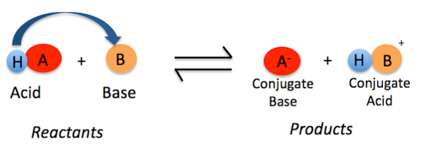
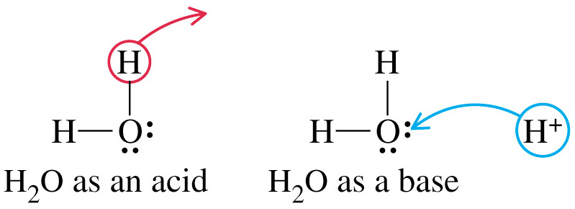
Bronsted-Lowery Acids & Bases
Source
According to Bronsted-Lowery (B.L.) an acid is a "proton donor" and a base is a "proton acceptor.“ The proton here is shown as a hydrogen.
The acid’s conjugate base is the anion.
The base’s conjugate acid now has the proton (hydrogen ion).
Video
Quizlet
Amphoteric nature of water
Water acts as both an acid & a base.
H₂O ←→ H⁺ + OH⁻
2H₂O ←→ H₃O⁺ + OH⁻
LO 3.7: The student is able to identify compounds as Bronsted-Lowry acids, bases and/or conjugate acid-base pairs, using proton-transfer reactions to justify the identification.

Slide 12
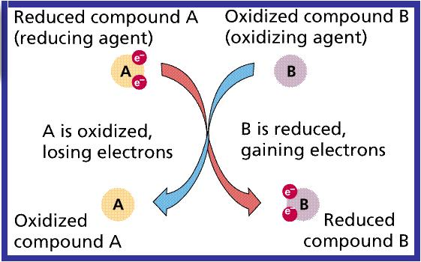
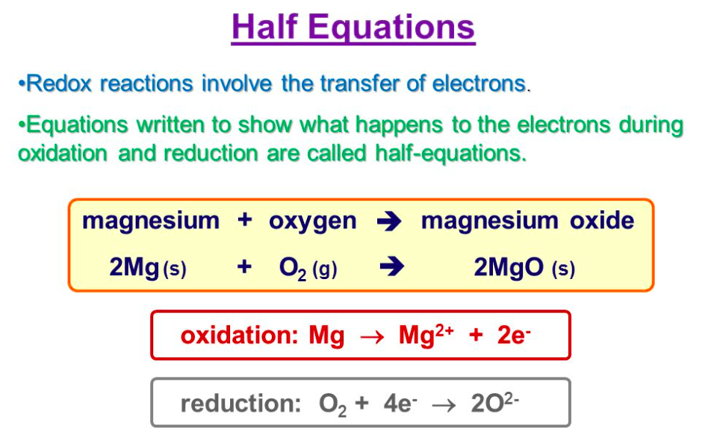
Redox Reactions
Source
When an electron is transferred, it is called a redox reaction. When something is reduced, the RED part of redox, it gains electrons. You may have a difficult time with this definition because when something is reduced, it usually means that it is losing something. In this case, it is a reduction in charge. Remember, electrons are negatively charged so if something is being reduced, it's getting more negatively charged by receiving more electrons. The other reaction that is coupled with this is called oxidation--the "OX" part of redox. Whenever something is reduced, the electron it gains has to come from somewhere. The oxidation is the loss of an electron, so if an atom is oxidized it loses its electron to another atom. And these are always coupled reactions. If one molecule is oxidized, another molecule must be reduced and vice versa: the electron must go somewhere.
Video
OILRIG
LO 3.8: The student is able to identify redox reactions and justify the identification in terms of electron transfer

Slide 13
Redox Titrations
Source
A redox titration (also called an
oxidation-reduction titration) can accurately determine the concentration of an unknown analyte by measuring it against a standardized titrant. A common example is the redox titration of a standardized solution of potassium permanganate (KMnO₄) against an analyte containing an unknown concentration of iron (II) ions (Fe²⁺). The balanced reaction in acidic solution is as follows:
MnO₄⁻ + 5Fe²⁺ + 8H⁺ → 5Fe³⁺ + Mn²⁺ + 4H₂O
In this case, the use of KMnO₄ as a titrant is particularly useful, because it can act as its own indicator; this is due to the fact that the KMnO₄ solution is bright purple, while the Fe²⁺ solution is colorless. It is therefore possible to see when the titration has reached its endpoint, because the solution will remain slightly purple from the unreacted KMnO₄
Video
LO 3.9: The student is able to design and/or interpret the results of an experiment involving a redox titration

Slide 14
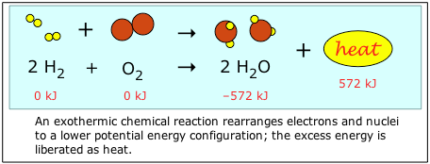
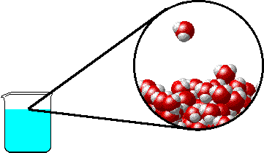
Evidence of Chemical Change
Source
Note: it is a common misconception that boiling water makes O₂ and H₂ gas. Notice that the water molecule stays intact as the water boils. Covalent bonds are not broken with during this phase change- only intermolecular attractions (hydrogen bonds) between water molecules.
Video
Video
Video
Chemical Changes:
Production of a gas:
2KClO₃ _{(s)} + heat → 2KCl _{(s)} + 3O_{2 (g)}
Formation of a precipitate:
AgNO₃) _{(aq)} + KCl _{(aq)} → AgCl _{(s)}+ 2KNO_{3 (aq)}
Change in color:
Two white solids react to produce a mixture of a yellow and a white solid when shaken forcefully!
Pb(NO₃)_{2 (s)} + 2KI _{(s)} → PbI₂ _{(s)}+ 2KNO_{3 (s)}
Production of heat*:
2 Mg _{(s)} + O_{2 (s)} → 2MgO _{(s)} + heat
*can also include the absorption of heat
Physical Changes:
may produce similar visible evidence (i.e. boiling water creates “bubbles,” but bonds are not broken and reformed. No new substances are made.
LO 3.10: Evaluate the classification of a process as a physical, chemical, or ambiguous change based on both macroscopic observations and the distinction between rearrangement of covalent interactions and noncovalent interactions.

Slide 15
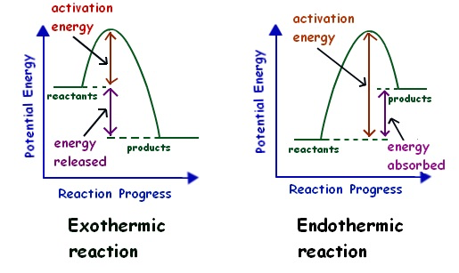
Energy Changes
Source
Chemical reactions involve the formation of new products
Bonds between atoms or ions in the reactants must be BROKEN (the enthalpy of the system is increasing … ENDOTHERMIC process)
Bonds are then FORMED between atoms or ions to make the producsts of the reaction. (the enthalpy of hte system is decreasing...EXOTHERMIC process)
Video
Video
LO 3.11: The student is able to interpret observations regarding macroscopic energy changes associated with a reaction or process to generate a relevant symbolic and/or graphical representation of the energy changes.

Slide 16
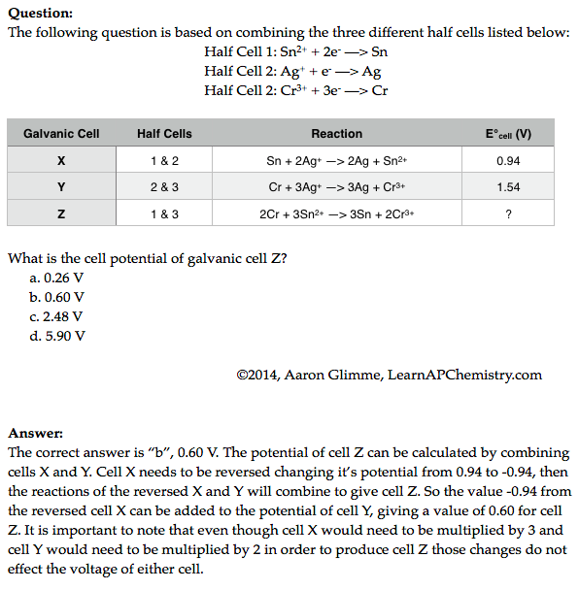
Galvanic Cell Potential
Source
Video
Video
Click reveals answer and explanation.
LO 3.12: Make qualitative or quantitative predictions about galvanic or electrolytic reactions based on half-cell reactions and potentials and/or Faraday’s laws.

Slide 17
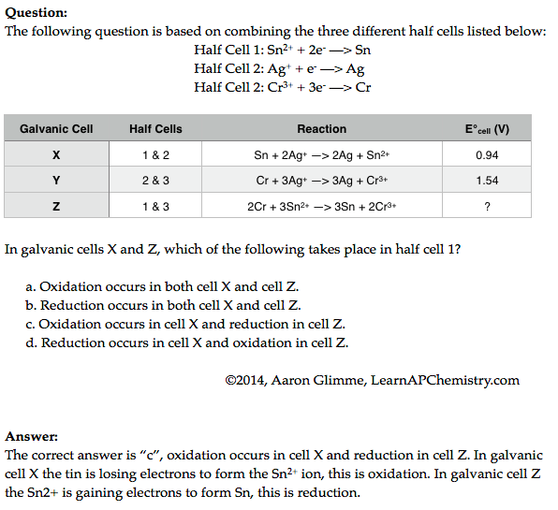
Redox Reactions and Half Cells
Source
Video
Video
LO 3.13: The student can analyze data regarding galvanic or electrolytic cells to identify properties of the underlying redox reactions

Slide 18
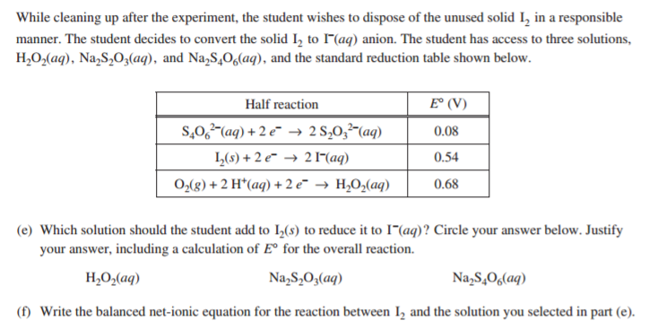
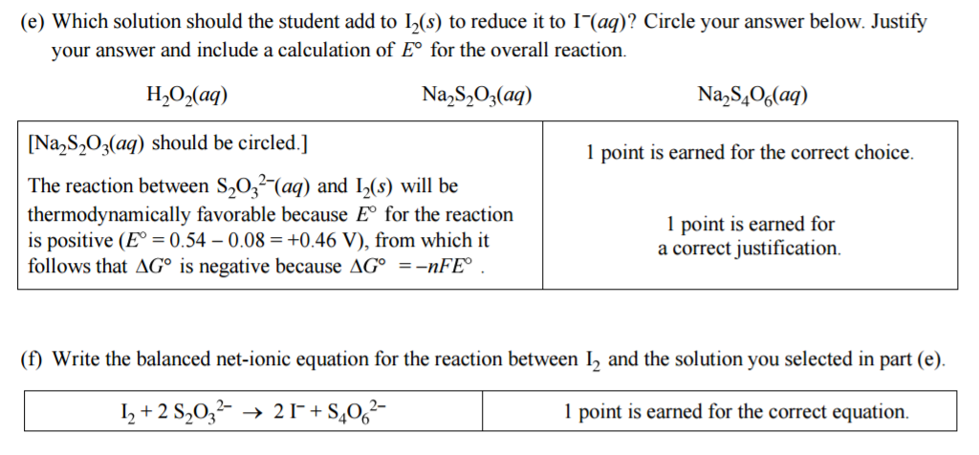
2016 FRQ #3
This question drew heavily from Big Idea #3

Slide 19
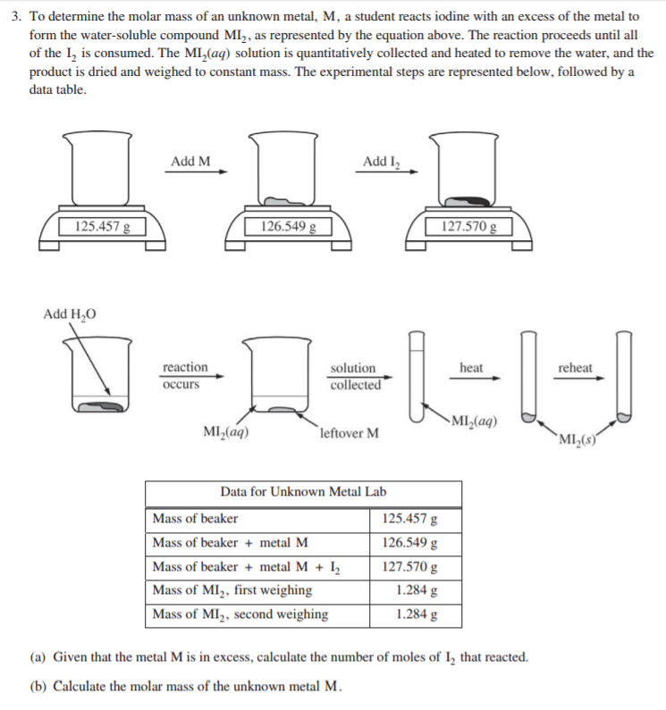
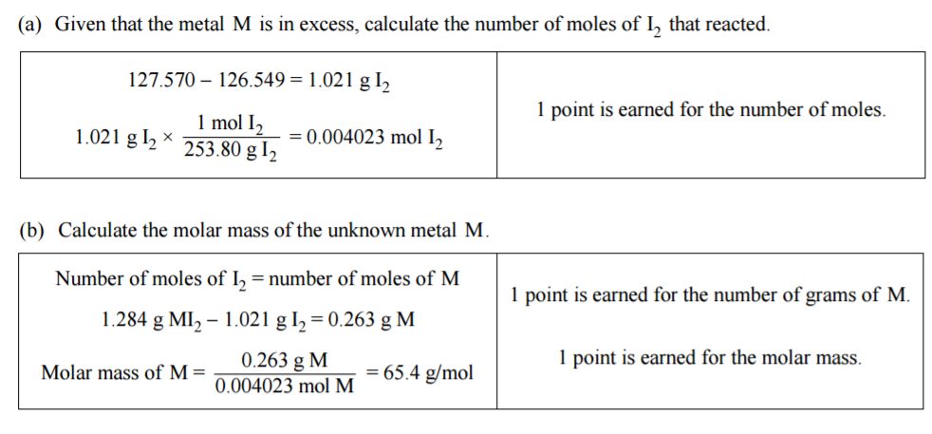
2016 FRQ #3
This question drew heavily from Big Idea #3

Slide 20
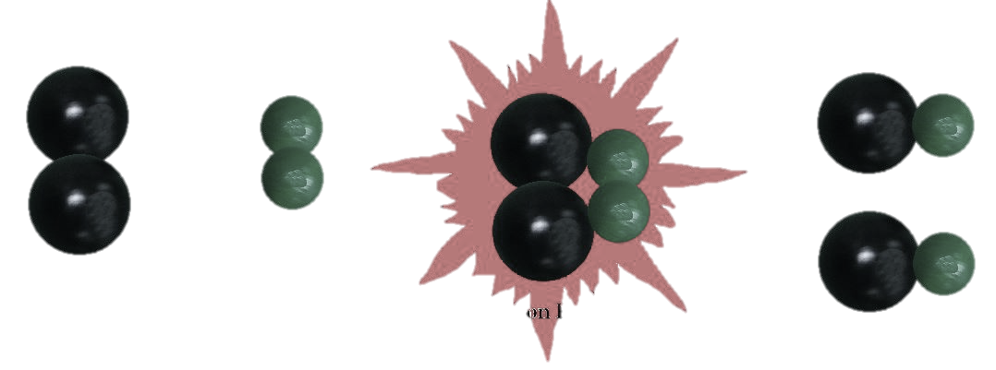
Big Idea #4
Kinetics

Slide 21
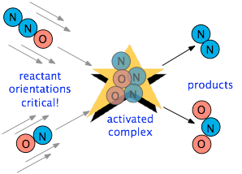
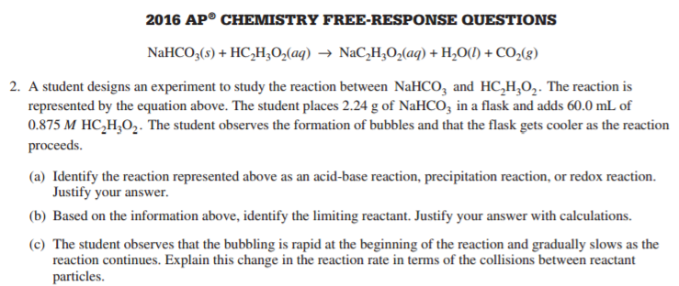
Factors Affecting Reaction Rate
Source
Factors that Affect Reaction Rate
State of reactants
Rate increases as state changes from solid → gas as increased molecular movement allows for more opportunity for collision
Greater surface area of solids will increase rate as more reactant is exposed and able participate in collisions
Temperature - more kinetic energy leads to more successful collisions between molecules
Concentration – more reactants → more collisions
Use of a catalyst – affect the mechanism of reaction leading to faster rate
Video
Collision theory states that reactants must collide in the correct orientation and with enough energy for the molecules to react; changing the number of collisions will affect the reaction rate
Rate is the change in concentration over time
Δ[A] / t
LO 4.1: The student is able to design and/or interpret the results of an experiment regarding the factors (i.e., temperature, concentration, surface area) that may influence the rate of a reaction.

Slide 22
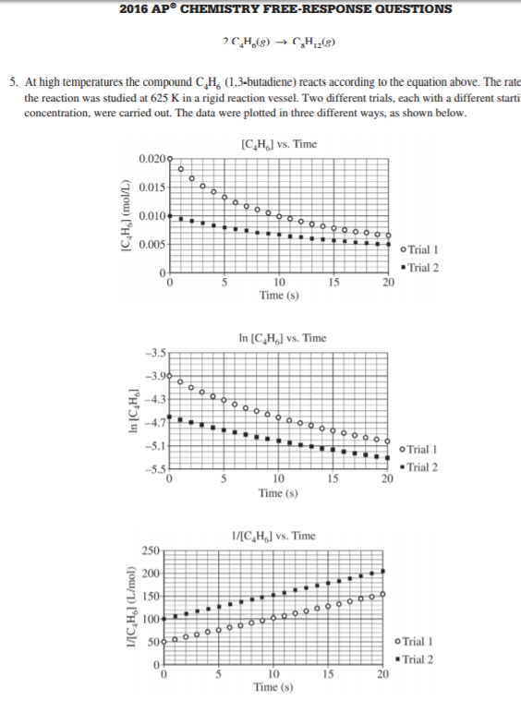
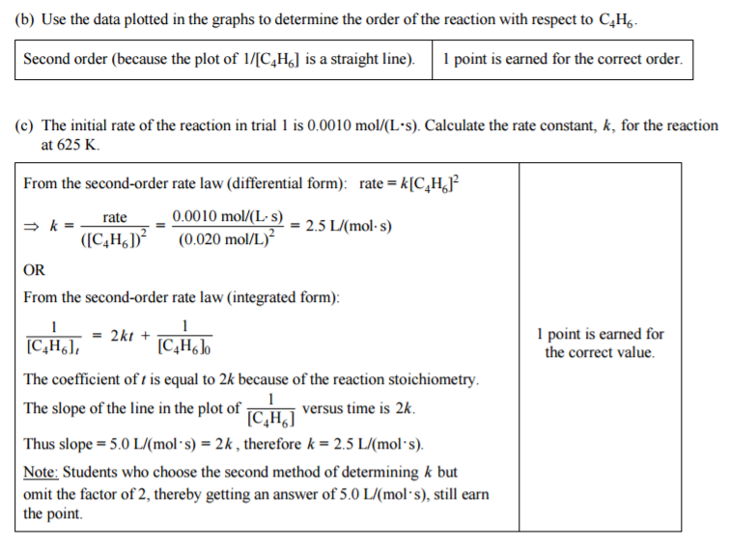
Determining Rate Order
Source
Rate law for a reaction has the form: rate = k [A]^{m}[B]^{n}… (only reactants are part of the rate law)
Exponents (m, n, etc. ) are determined from examining data, not coefficients:
for A + B → C
The overall rate expression for the reaction is rate = k [B]
k is the rate constant and is determined experimentally by plugging in data into the rate expression
When [A] is doubled, the rate do not change, so the reaction is zero order with respect to A
When [B] is doubled, the rate doubles, so the reaction is first order with respect to B
Trial | Initial [A] (mol/L) | Initial [B] (mol/L) | Initial Rate (mol/(L•s)
1 | 0.100 | 0.100 | 0.002
2 | 0.200 | 0.100 | 0.002
3 | 0.200 | 0.200 | 0.004
Video
Plot to create a straight line graph:
Zeroth Order First Order Second Order
[A] / Time ln[A] / Time 1/[A] / time
The first and second order integrated rate laws can be found on the Kinetics section of the AP Equations Sheet
LO 4.2: The student is able to analyze concentration vs. time data to determine the rate law for a zeroth-, first-, or second-order reaction.

Slide 23
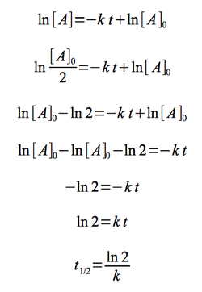
Half-life (First Order)
Source
Time needed for the concentration of reactant to reach half its initial value
Time to reach half concentration is dependent on k, not initial concentration
Half life remains constant in a first order reaction
Example: when t_{1/2}= 30 sec, the concentration is halved each 30 seconds
Video
The first order half life equation is derived from the first order integrated rate law
Initial Conditions After 30 seconds After 60 seconds
(12 molecules) (6 molecules) (3 molecules)
LO 4.3: The student is able to connect the half-life of a reaction to the rate constant of a first-order reaction and justify the use of this relation in terms of the reaction being a first-order reaction.

Slide 24
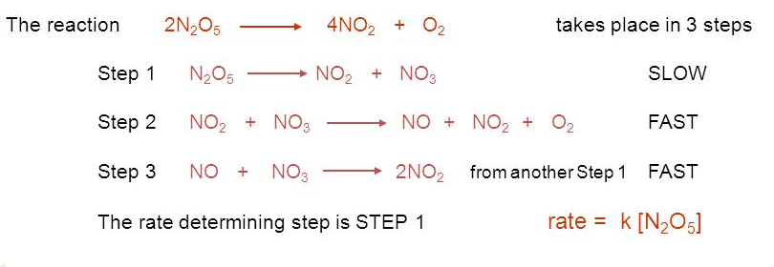
Collision Theory and Reaction Mechanisms
Source
In a successful collision
Molecules have enough energy to overcome E_{a.}
Molecules collide with proper orientation to break the bonds.
In a Mechanism
The rate law of any elementary reaction can be written from its stoichiometry.
The rate law of the slow step is the rate law of the overall reaction.
The larger the rate constant, the larger the percentage of molecules having successful collisions.
Video
Click here after you identify the rate determining step AND have written the rate law
LO: 4.4: Connect the rate law for an elementary reaction to the frequency/success of molecular collisions, including connecting the frequency and success to the order and rate constant.

Slide 25
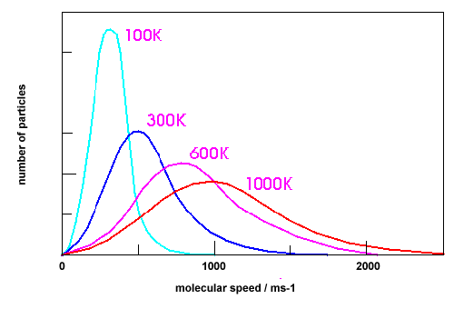
Successful and Unsuccessful Molecular Collisions
Source
Assume that all of these curves show the distribution of molecular speeds for the same substance.
Video
A
Curve D because a larger number of its particles have higher kinetic energies, and so are more likely to overcome the activation energy barrier when they collide.
Click here after you have chosen the correct curve and justified your answer.
B
C
D
Question: Which curve indicates the particles most likely to produce collisions that result in a chemical change? Justify your selection.
LO 4.5: The student is able to explain the difference between collisions that convert reactants to products and those that do not in terms of energy distributions and molecular orientation.

Slide 26
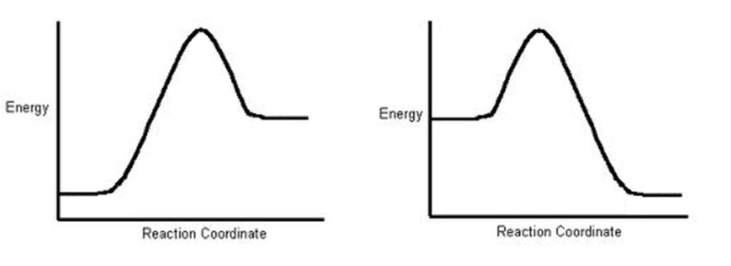
Temperature and Reaction Rate
Source
Video
Reaction A
Reaction B
In order for both Reaction A and Reaction B to proceed in the forward direction at the same rate, which reaction would need to be at the higher temperature? Justify your choice.
Click here to see answer and justification.
The greater the activation energy, the slower the reaction. Since Reaction A has a greater activation energy, it should be slower than Reaction B at the same temperature. To bring its rate up to that of Reaction B would require increasing its temperature. Important note: It does not matter at all, in answering this question, that Reaction A is endothermic and Reaction B is exothermic.
LO 4.6: The student is able to use representations of the energy profile for an elementary reaction (from the reactants, through the transition state, to the products) to make qualitative predictions regarding the relative temperature dependence of the reaction rate.

Slide 27
Reaction Mechanisms
Source
X₂ + Y₂ → X₂Y₂ rate = k[X₂]
A reaction and its experimentally determined rate law are represented above. A chemist proposes two different possible mechanisms for the reaction, which are given below.
Mechanism 1 Mechanism 2
X₂ → 2X (slow) X₂ → 2X (slow)
X + Y₂ → XY₂ (fast) X + Y₂ → XY + Y (fast)
X + XY₂ → X₂Y₂ (fast) X + XY → X₂Y (fast)
X₂Y + Y → X₂Y₂ (fast)
Based on the information above, which of the mechanisms is/are consistent with the rate law? List the intermediates in each mechanism:
Video
Answer: Both are consistent. In both mechanisms, the molecularity of the slow, rate determining step is consistent with the rate law. Furthermore, the sum of the elementary steps for both mechanisms gives the overall balanced equation for the reaction.
Intermediates in mechanism 1: X, XY2. Intermediates in mechanism 2: X, XY, Y, X2Y
LO 4.7: Evaluate alternative explanations, as expressed by reaction mechanisms, to determine which are consistent with data regarding the overall rate of a reaction, and data that can be used to infer the presence of a reaction intermediate.

Slide 28
Reaction Mechanisms
Source
The rate law for a reaction is found to be Rate = k[A]²[B]. What is the intermediate? Which of the following mechanisms gives this rate law?
I. A + B ⇄ E (fast)
E + B → C + D (slow)
II. A + B ⇄ E (fast)
E + A → C + D (slow)
III. A + A → E (slow)
E + B → C + D (fast)
A. I
B. II
C. III
D. Two of these
Video
Answer: E is the intermediate. Only Mechanism II is consistent with the rate law. Whenever a fast equilibrium step producing an intermediate precedes the slow rate determining step and we want to remove the intermediate from the rate law, we can solve for the concentration of the intermediate by assuming that an equilibrium is established in the fast step. The concentration of the intermediate in the rate determining slow step can be replaced with an expression derived from the equilibrium constant [E] =K_{eq}[A][B]. This substitution gives us the desired rate law: rate = k’[A]²[B]
LO 4.7 The student is able to evaluate alternative explanations, as expressed by reaction mechanisms, to determine which are consistent with data regarding the overall rate of a reaction, and data that can be used to infer the presence of a reaction intermediate.

Slide 29
Draw and label axes for the energy profiles below. Match the curves with the appropriate description.
Reaction Mechanisms and Energy Profiles – Practice Problem
exothermic reaction with a 2 step mechanism where the first step is slow. | endothermic reaction with a 2 step mechanism where the first step is slow.
endothermic reaction with a 2 step mechanism where the second step is slow. | exothermic reaction with a 1 step mechanism.
exothermic reaction with a 2 step mechanism where the second step is slow. | endothermic reaction with a 1 step mechanism.
D
C
F
Potential Energy
Potential Energy
Potential Energy
Reaction pathway
Reaction pathway
Reaction pathway
E
B
A
Potential Energy
Potential Energy
Potential Energy
Reaction pathway
Reaction pathway
Reaction pathway
LO 4.7 Cont. Dena K. Leggett, PhD Advanced Chemistry Teacher Allen High School Copyright 2015

Slide 30
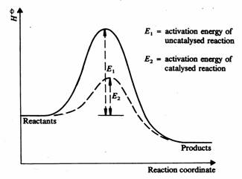
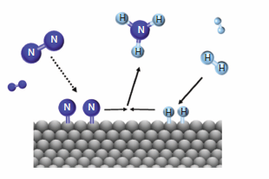
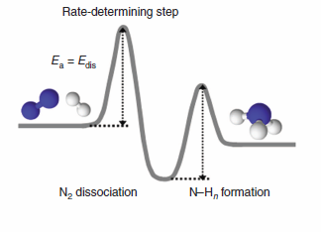
Catalysts
Source
A catalyst can stabilize a transition state, lowering
the activation energy.
A catalyst can participate in the formation of a new reaction intermediate,
providing a new reaction pathway.
Video
The rate of the Haber process for the synthesis of ammonia is increased
by the use of a heterogeneous catalyst which provides a lower energy pathway.
N₂(g) + 2H₂ (g) → iron-based catalyst + 2NH₃ (g)
Iron based catalyst
LO 4.8 The student can translate among reaction energy profile representations, particulate representations, and symbolic representations (chemical equations) of a chemical reaction occurring in the presence and absence of a catalyst.

Slide 31
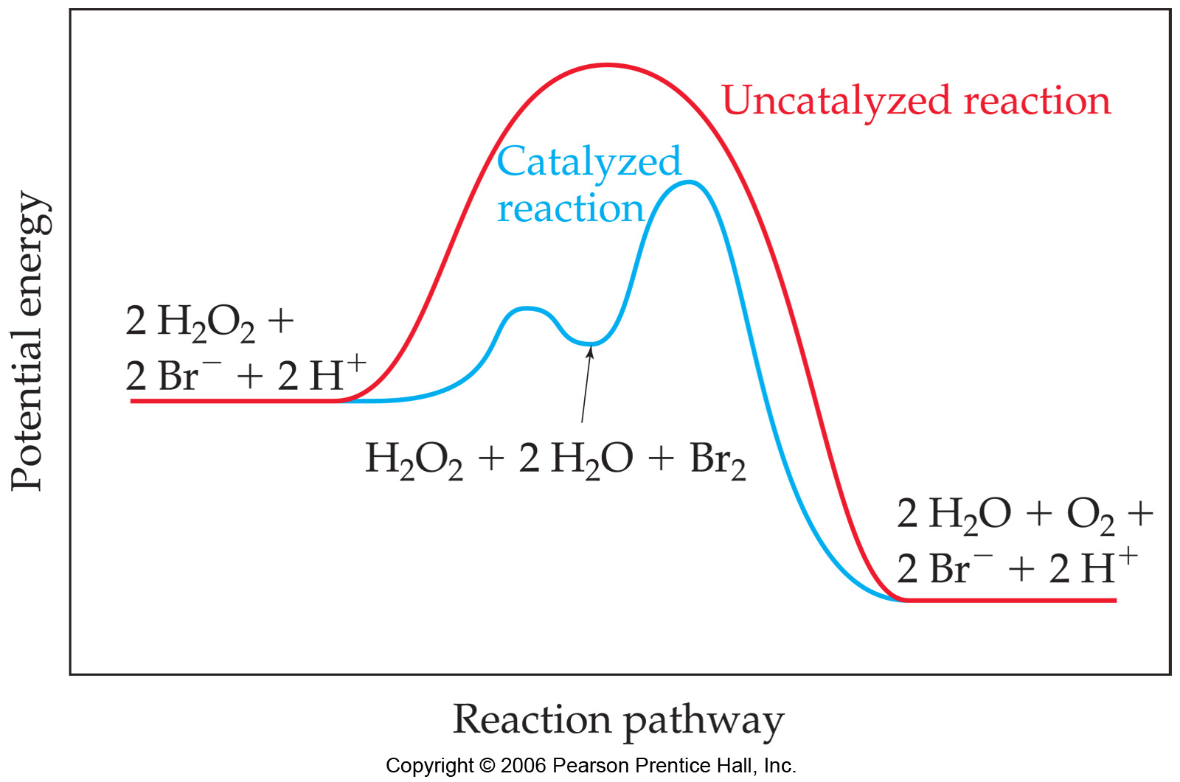
Catalysts
Source
catalysts provide alternative mechanisms with lower activation energy
In acid-base catalysis, a reactant either gains or loses a proton,
changing the rate of the reaction.
b. In surface catalysis, either a new reaction intermediate is formed or the probability of successful collisions is increased.
Video
c. In Enzyme catalysis enzymes bind to reactants in a way that lowers the activation energy. Other enzymes react to form new reaction intermediates.
Homogeneous catalysis
of the decomposition of H2O2
LO 4.9 The student is able to explain changes in reaction rates arising from the use of acid-base catalysts, surface catalysts, or enzyme catalysts, including selecting appropriate mechanisms with or without the catalyst present.

